Slide 1
Year 6 Information Meeting
September 11th 2019

Slide 2
Areas we’ll cover
What we expect
Secondary transfer
Home learning
SATs

Slide 3
Responsibilities- To whom? Parents/Teachers/School/Themselves
Expectations- Work & how they conduct themselves both in and out of the classroom
Mobile phones- not during school time

Slide 5
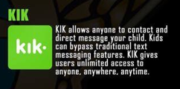
Communication/social media apps

Slide 6
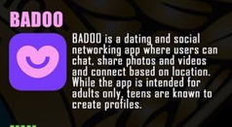
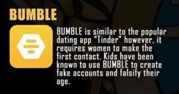
Not applicable to Primary children but be aware of these dating apps.

Slide 8
What can you do?
Set expectations – safe use, down time, usage limit
Have open conversations
Agree on consequences and rewards
http://mathsathome.lgfl.org.uk/
http://grammar.lgfl.org.uk/

Slide 9
Schools Admissions
Went ‘live’ on September 1st
You have until 31st October
First offer day: 2nd March 2020
You can apply for up to 6 schools
Decide order of preference
Easier to do it online – will need to create/remember login details

Slide 10
How to Start
Type in Brent Admissions
CLICK HERE

Slide 11
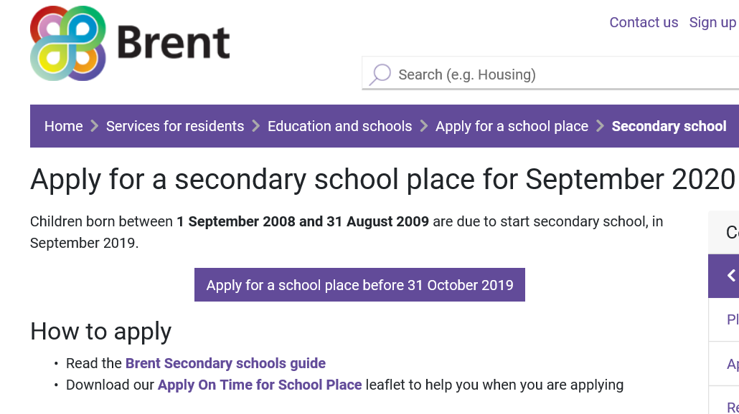

Slide 12
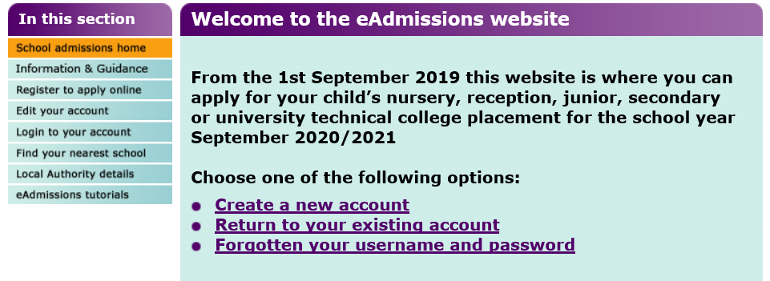
CLICK HERE
OR HERE

Slide 13
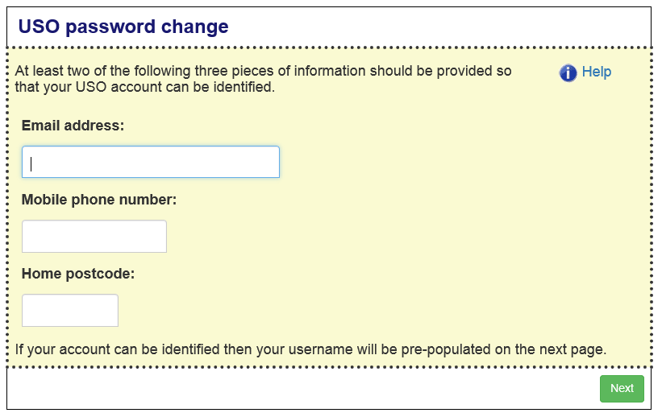
OR

Slide 14
Key Information
Do not just put one down – or the same one 6 times!
You will only be offered one school
It will be the highest ranked school that you are eligible for
Look at the way the schools admit pupils
If there are no other siblings at a school, the next criteria tends to be feeder schools or distance from your house
You will go on the waiting list for any school above your offer that you did not get, for the next academic year only
If applying for a school outside Brent, still use the Brent form.

Slide 15
Schools Admissions Criteria

Slide 16
Key Dates
Apply by 31st October 2019
Offer date 2nd March 2020
Deadline for acceptance –
16th March 2020

Slide 18
SATs
11th – 14th May 2020
Monday Spelling, Punctuation and Grammar
Tuesday Reading
Wednesday Maths Arithmetic and Reasoning
Thursday Reasoning

Slide 19
Scaled Scores 2019
READING
SPAG
MATHS
35 | 99
36 | 100
37 | 100
38 | 100
39 | 101
40 | 101
41 | 102
42 | 102
57 | 99
58 | 100
59 | 100
60 | 100
61 | 100
62 | 101
63 | 101
64 | 101
65 | 101
66 | 101
27 | 99
28 | 100
29 | 100
30 | 101
31 | 102
32 | 102
40 | 109
41 | 110
42 | 111
43 | 113
53 | 109
54 | 109
55 | 110
56 | 111
57 | 111
58 | 112
94 | 109
95 | 110
96 | 110
97 | 110
98 | 111
99 | 111

Slide 20
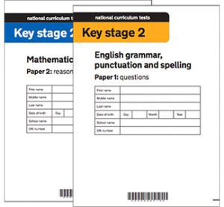
PLEASE DO NOT USE PAST PAPERS

Slide 21
Wording of questions - Reading
Inferential – What impression do you get…? Why did Oliver find it difficult to …? How do you know that…? What evidence is there of…? Explain what this description suggests about…? Why were the dodos curious and afraid?

Slide 22
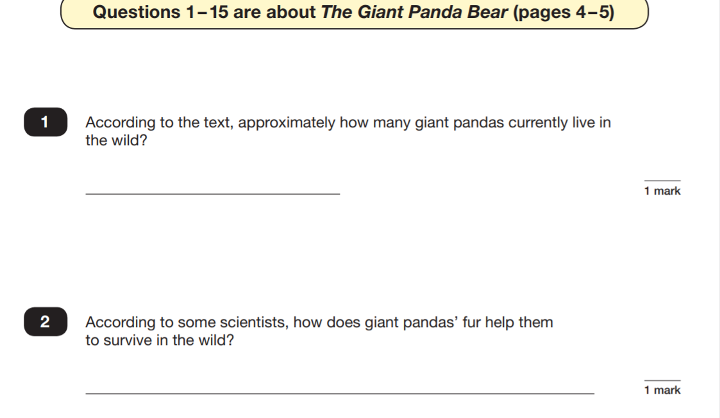
Reading Questions

Slide 23
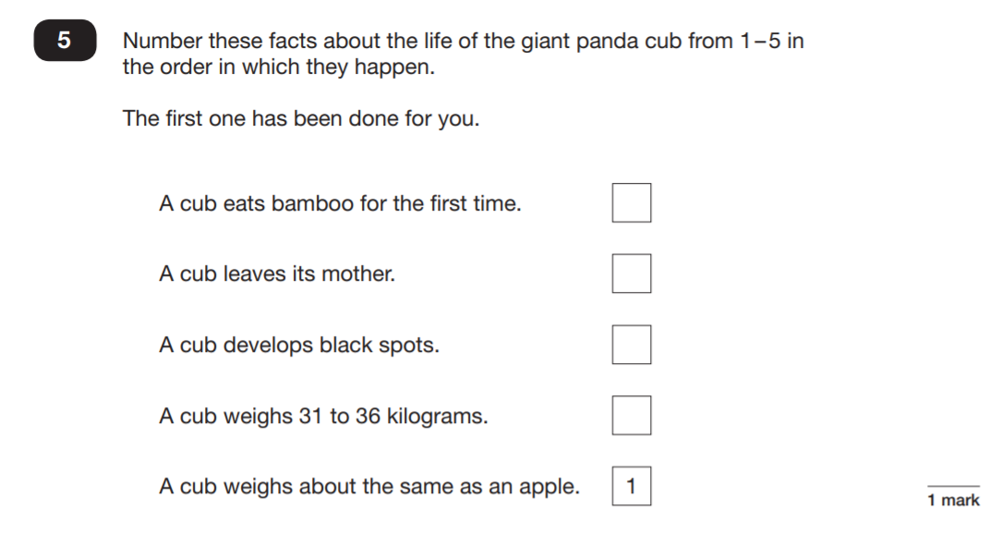
Reading Questions

Slide 24
Reading Questions

Slide 25
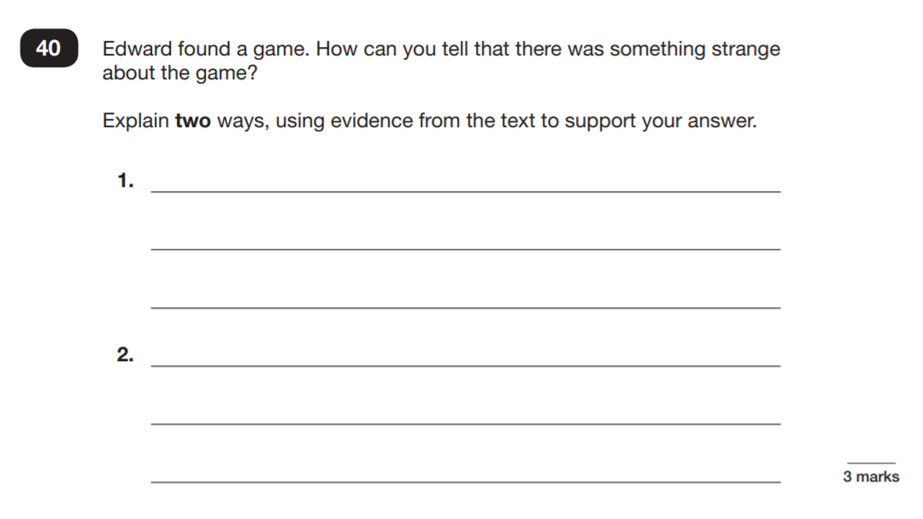
Reading Questions

Slide 26
Tips for Reading
Ensure there is regular reading at home.
Follow up your child’s reading with questions to assess their understanding.
Read a range of texts including poetry.
Set goals and rewards for reading.
Make it a family activity – show children your love for reading.
Make reading memorable and fun – e.g. Drama activities, art and watching related videos or films.
Keep a note book with revision hints and tips
Please do not use past papers at home

Slide 27
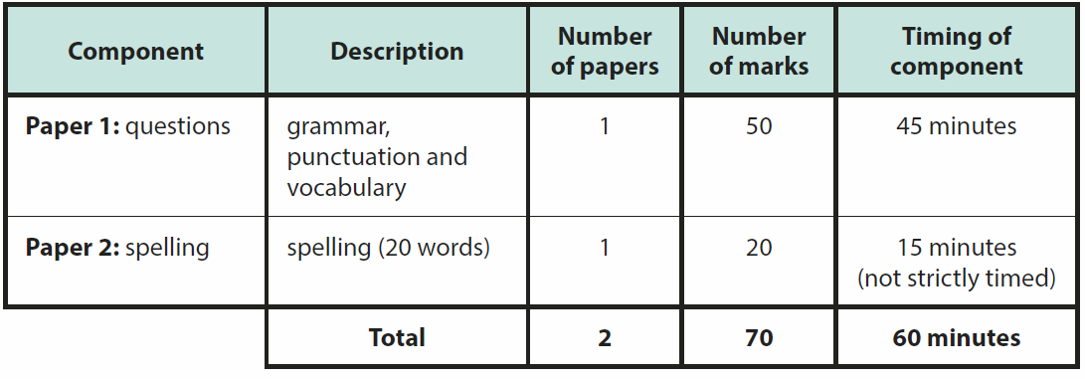
SPAG

Slide 28
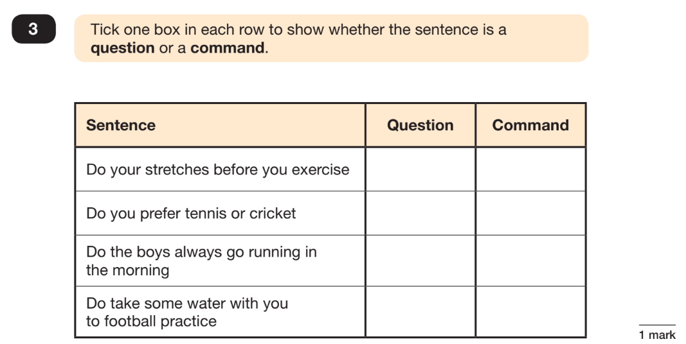
SPAG Questions

Slide 29
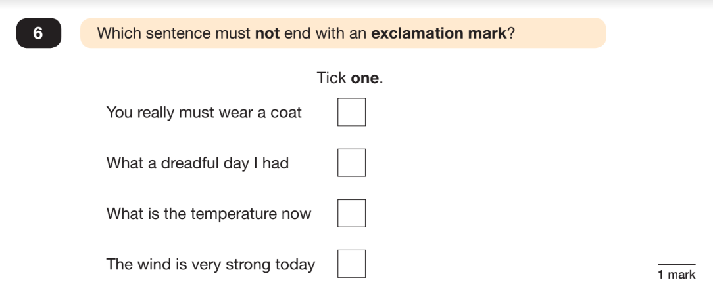
SPAG Questions

Slide 30
SPAG Questions

Slide 31
Tips for SPAG
Ensure children complete the homework provided.
Where possible, ensure your child is using the correct English when speaking.
Practise writing spellings daily.
Practise putting spellings into a sentence to secure punctuation and grammar.
Check that your child is using a dictionary to look up the meaning of new words.
Make sure children understand the terminology.
Please do not use past papers at home

Slide 32
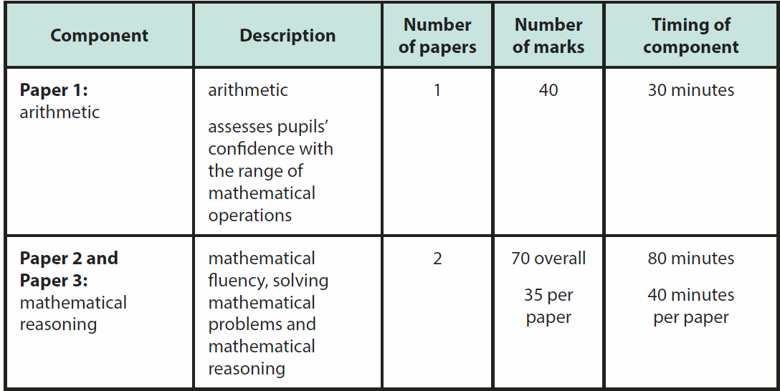
Maths Test

Slide 33
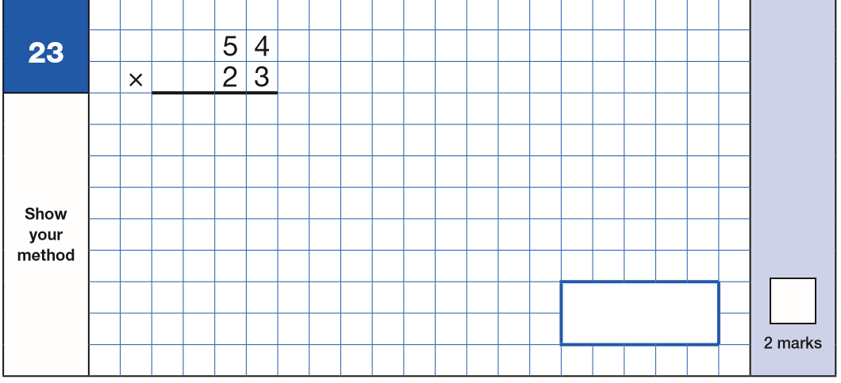
Maths - Arithmetic

Slide 34
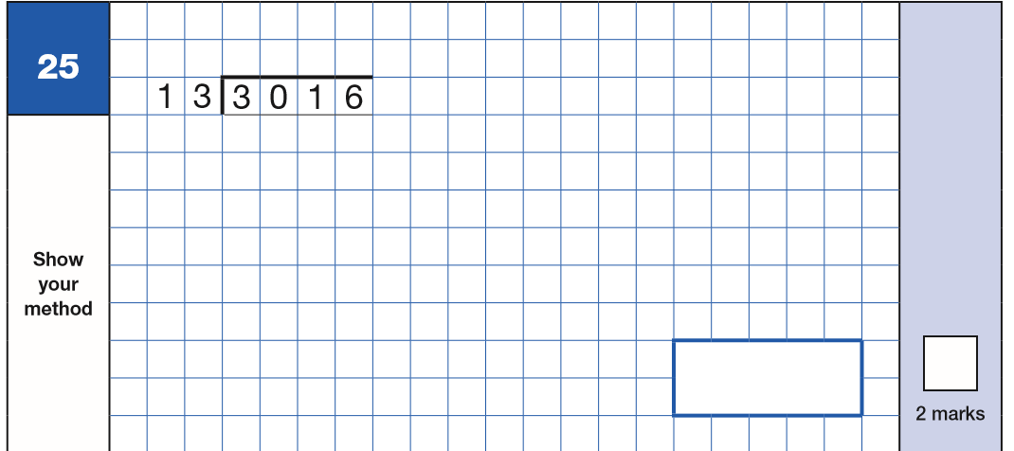

Slide 35
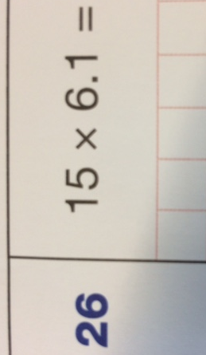
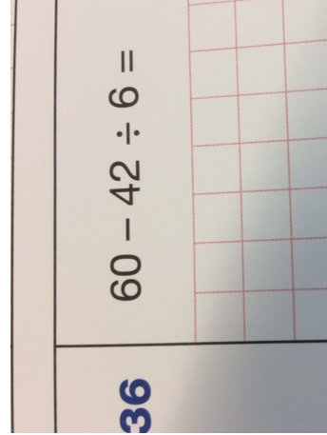
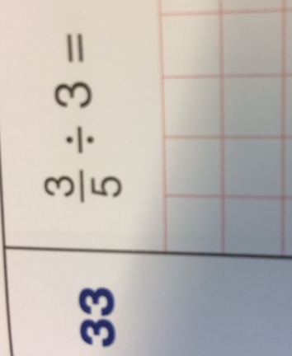

Slide 36
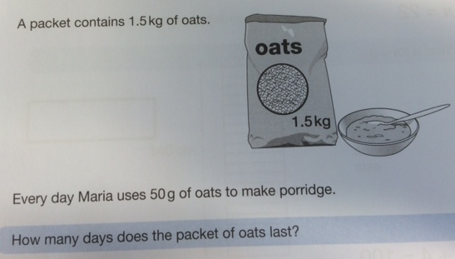
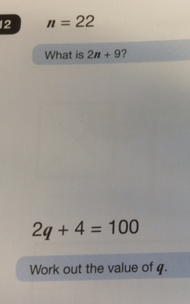
Maths -Reasoning

Slide 37
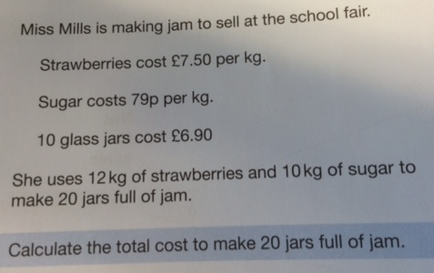
Maths Reasoning

Slide 38
Tips for Maths
Know your multiplication and division facts
Practise halving and doubling two and three digit numbers
Halve 90
Double 90
Write your numerals clearly
Write your answers in the box
If you don’t know how to do something ask; don’t leave it too late.
Keep a note book with revision hints and tips
Please do not use past papers at home

Slide 39
Home Learning

Slide 40
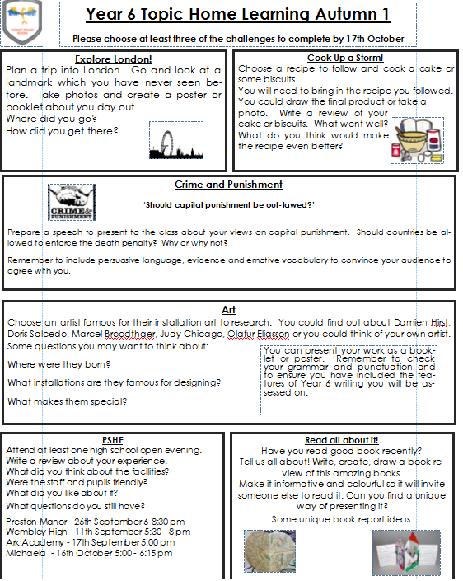

Slide 42
Resources- We will provide these in the next couple of weeks

Slide 43
Spellings
Monday the children will have a ‘cold’ test and will take home a list of spellings
Friday the children will be retested on the spellings they have been learning throughout the week.
Spellings are linked to our Spelling Scheme.
In addition they will also need to learn to read and spell the Year 5 / 6 Statutory Spellings.

Slide 44
