Slide 1
Wembley COVID-19 Challenge
Years 5 & 6

Slide 2
We want to show our support for all our key workers during the COVID-19 closure.
We have thought of a nice challenge to show our messages of support…

Slide 3
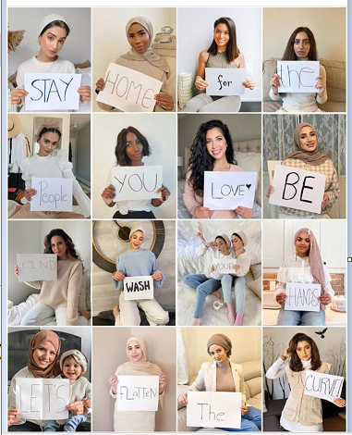
We need you to write and decorate one of the words in the message from your year group so we can put them into a collage like the one here.
There are some instructions to follow…

Slide 4
Challenge Instructions
Ask your parent/carer for permission to put your photograph on our school website, Twitter page and Instagram page.
Choose one of the words from your year group message.*
Using an A4 blank piece of paper, write and decorate your word.*
Make sure it is large enough for people to read.
Take a photograph of yourself holding your word, dressed in your school jumper and white shirt/polo shirt (school uniform only).
Ask your adult to email your photo to the email address below with your name and class – entries will only be taken from an adult’s email address.
learning@wembleyprimary.brent.sch.uk
Notes:
* Try to make sure the word is different to your friend’s chosen word and make sure we include the smaller words such as we, the, at
* You can decorate your word with the NHS logo, love hearts, rainbows

Slide 5
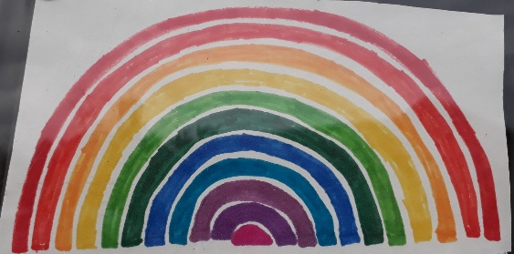
5W Please don’t roam; stay at home.
5P Stay home, don’t panic. We will beat this pandemic!
5S Stay home! Save lives! Help the NHS!
5F Stick to the rules, do not swerve. Together we will flatten the curve.
6W Stay safe! Together, we will get through this!
6P Doctors and nurses are my new superheroes!
6S If you want to save the world; stay at home.
6F Stay at home! Stay safe! Save lives!
Notes:
NB: If your word has a punctuation mark after it, don’t forget to include that.

Slide 6
Let’s show our Wembley Message of Support to all those people who are working hard and putting themselves at risk during this time.

