Slide 1
Year 3 Maths Week 2
Multiplication and Division:
Day 1: Division facts for 8x,
Day 2 and 3: Multiplying by one digit numbers by two digits numbers,
Day 4 and 5: Dividing two digit numbers by one digit numbers.

Slide 2
Day 1
Practice times tables for 10 minutes using:
https://www.timestables.co.uk/
https://www.topmarks.co.uk/maths-games/hit-the-button
or write some questions on paper to answer.

Slide 3
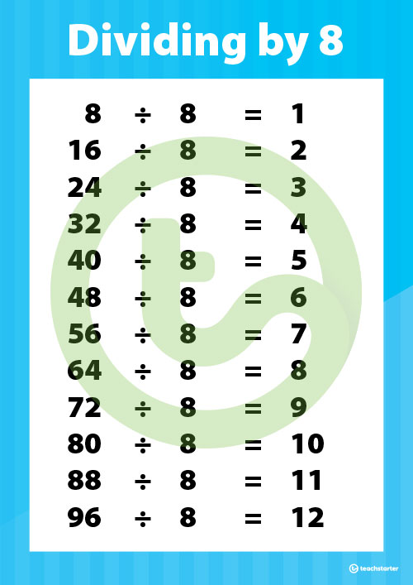
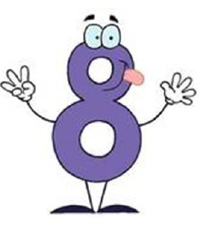
We are learning to divide by 8 .
Follow the slides and answer the questions.
The answers are here too.

Slide 4
https://www.youtube.com/watch?v=3kAWgxcQG8I

Slide 5
Can you count in 8s to solve this problem?

Slide 7
Can you count in 8s to solve this problem?

Slide 11
Now choose a challenge that is right for you and complete it. Most of you should do Challenge 2:

Slide 12
Here are the answers. Mark your own work!

Slide 13
Day 2
Practice times tables for 10 minutes using:
https://www.timestables.co.uk/
https://www.topmarks.co.uk/maths-games/hit-the-button
or write some questions on paper to answer.

Slide 14
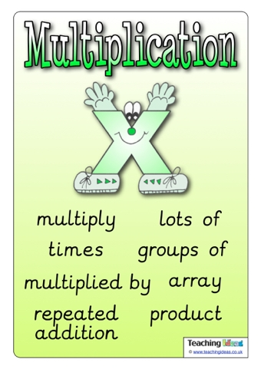
We are learning to multiply a 2 digit number by a 1 digit number.
Follow the slides and answer the questions.
The answers are here too.

Slide 15
21
21 x 3 =

Slide 17
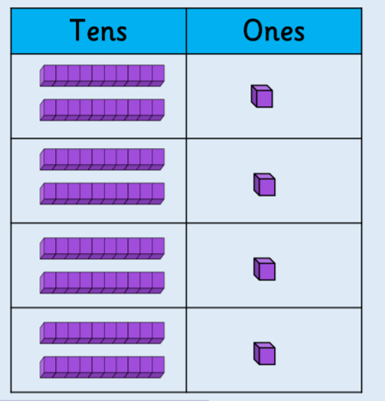
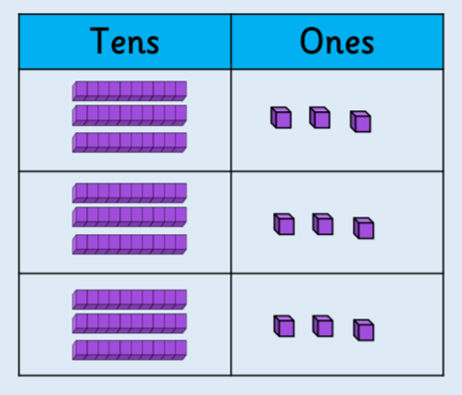
Draw the 10s and 1s to work these out:

Slide 19
Y
Try these. You can draw the tens and ones…
Draw the tens and ones:
The written method:
Or try the written method:
Step 1: Multiply the ones by the one digit number.
Step 2: Multiply the tens by the one digit number.

Slide 20
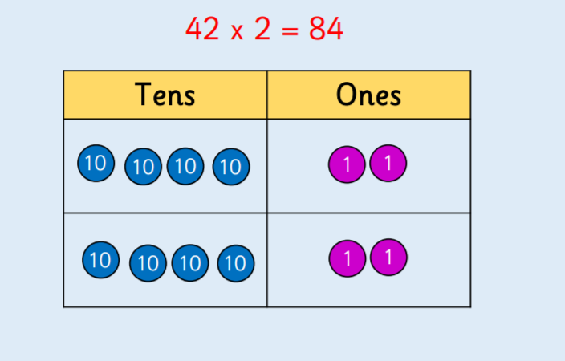
42
2
---
84
23
3
---
69
32
3
---
96
X
X
X

Slide 21
Now choose a challenge that is right for you and complete it using either method. Most of you should do Challenge 2:

Slide 22
Here are the answers. Mark your own work!

Slide 23
Day 3
Practice times tables for 10 minutes using:
https://www.timestables.co.uk/
https://www.topmarks.co.uk/maths-games/hit-the-button
or write some questions on paper to answer.

Slide 24
We are learning to multiply a 2 digit number by a 1 digit number.
Follow the slides and answer the questions.
The answers are here too.

Slide 25
https://www.youtube.com/watch?v=k3JRTxFZZIs
Watch this video that explains how to do the formal method of multiplication.
Follow the steps along to do 25 x 3 =

Slide 26
Follow the same steps to try 36 x 4 =
Step 1: Multiply the ones by the one digit number.
4 x 6 = 24
Step 2: Put the ones down and the tens up regrouped into the tens column.
Step 3: Multiply the tens by the one digit number.
4 x 3 tens = 12 tens
Step 4: Don’t forget to add on the regrouped tens before you write the answer.
12 tens + 2 tens = 14 tens
T O
3 6
4
1 4 4
2
X

Slide 29
Use the multiplication square to help you if you can’t remember a times table.

Slide 30
Now choose a challenge that is right for you and complete it. Most of you should do Challenge 2:

Slide 31
Here are the answers. Mark your own work!

Slide 32
Day 4
Practice times tables for 10 minutes using:
https://www.timestables.co.uk/
https://www.topmarks.co.uk/maths-games/hit-the-button
or write some questions on paper to answer.

Slide 33
We are learning to divide a two digit number by a one digit number.
Follow the slides and answer the questions.
The answers are here too.

Slide 34
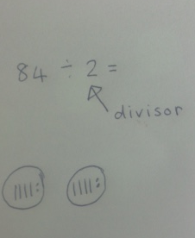
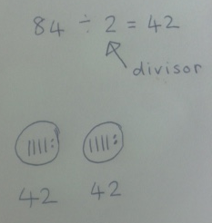
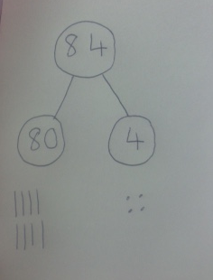
Solve 84 ÷ 2 =
Step 1: Partition the two digit number and draw the tens and ones.
Step 3: The answer is the number you have in one group.
Step 2 : Divide the tens and ones between the one digit divisor.

Slide 35
Use the same strategy to solve 66 ÷ 3 =
Step 1: Partition the two digit number and draw the tens and ones.
Step 2 : Divide the tens and ones by sharing between the one digit divisor.
Step 3: The answer is the number you have in one group.

Slide 36
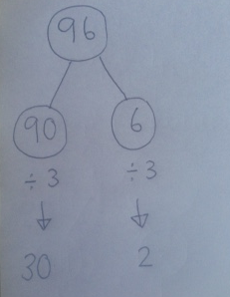
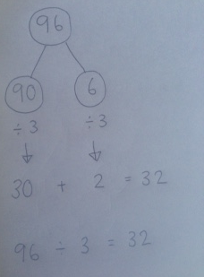
If you are feeling confident… solve 96 ÷ 3 =
Step 1: Partition the number into tens and ones.

Slide 39
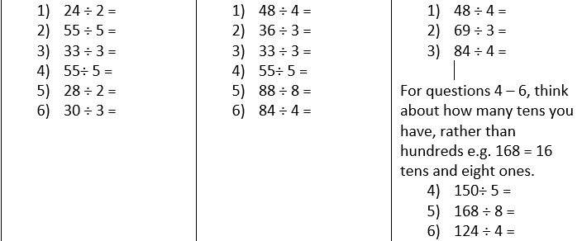
Now choose a challenge that is right for you and complete it. Most of you should do Challenge 2:

Slide 40
Here are the answers. Mark your own work!

Slide 41
Day 5
Practice times tables for 10 minutes using:
https://www.timestables.co.uk/
https://www.topmarks.co.uk/maths-games/hit-the-button
or write some questions on paper to answer.

Slide 42
We are learning to divide a two digit number by a one digit number.
Follow the slides and answer the questions.
The answers are here too.

Slide 43
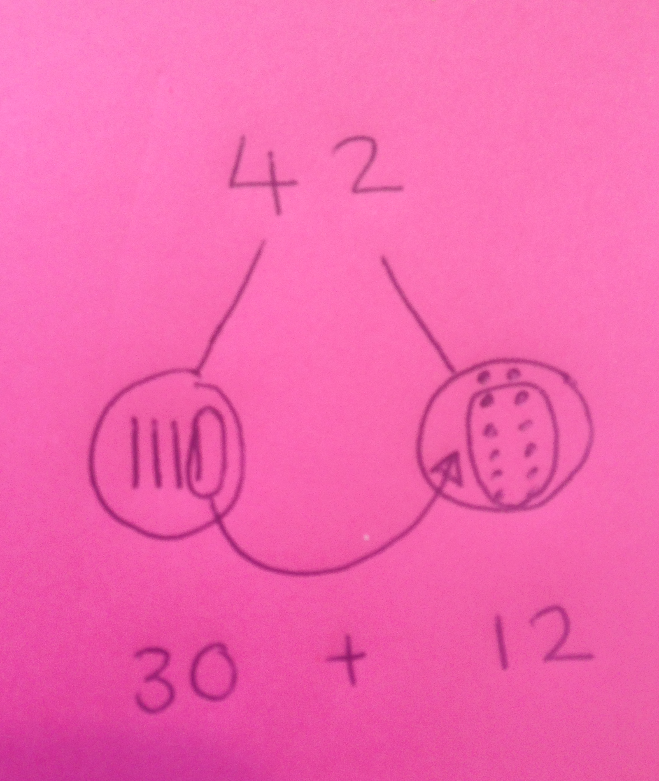
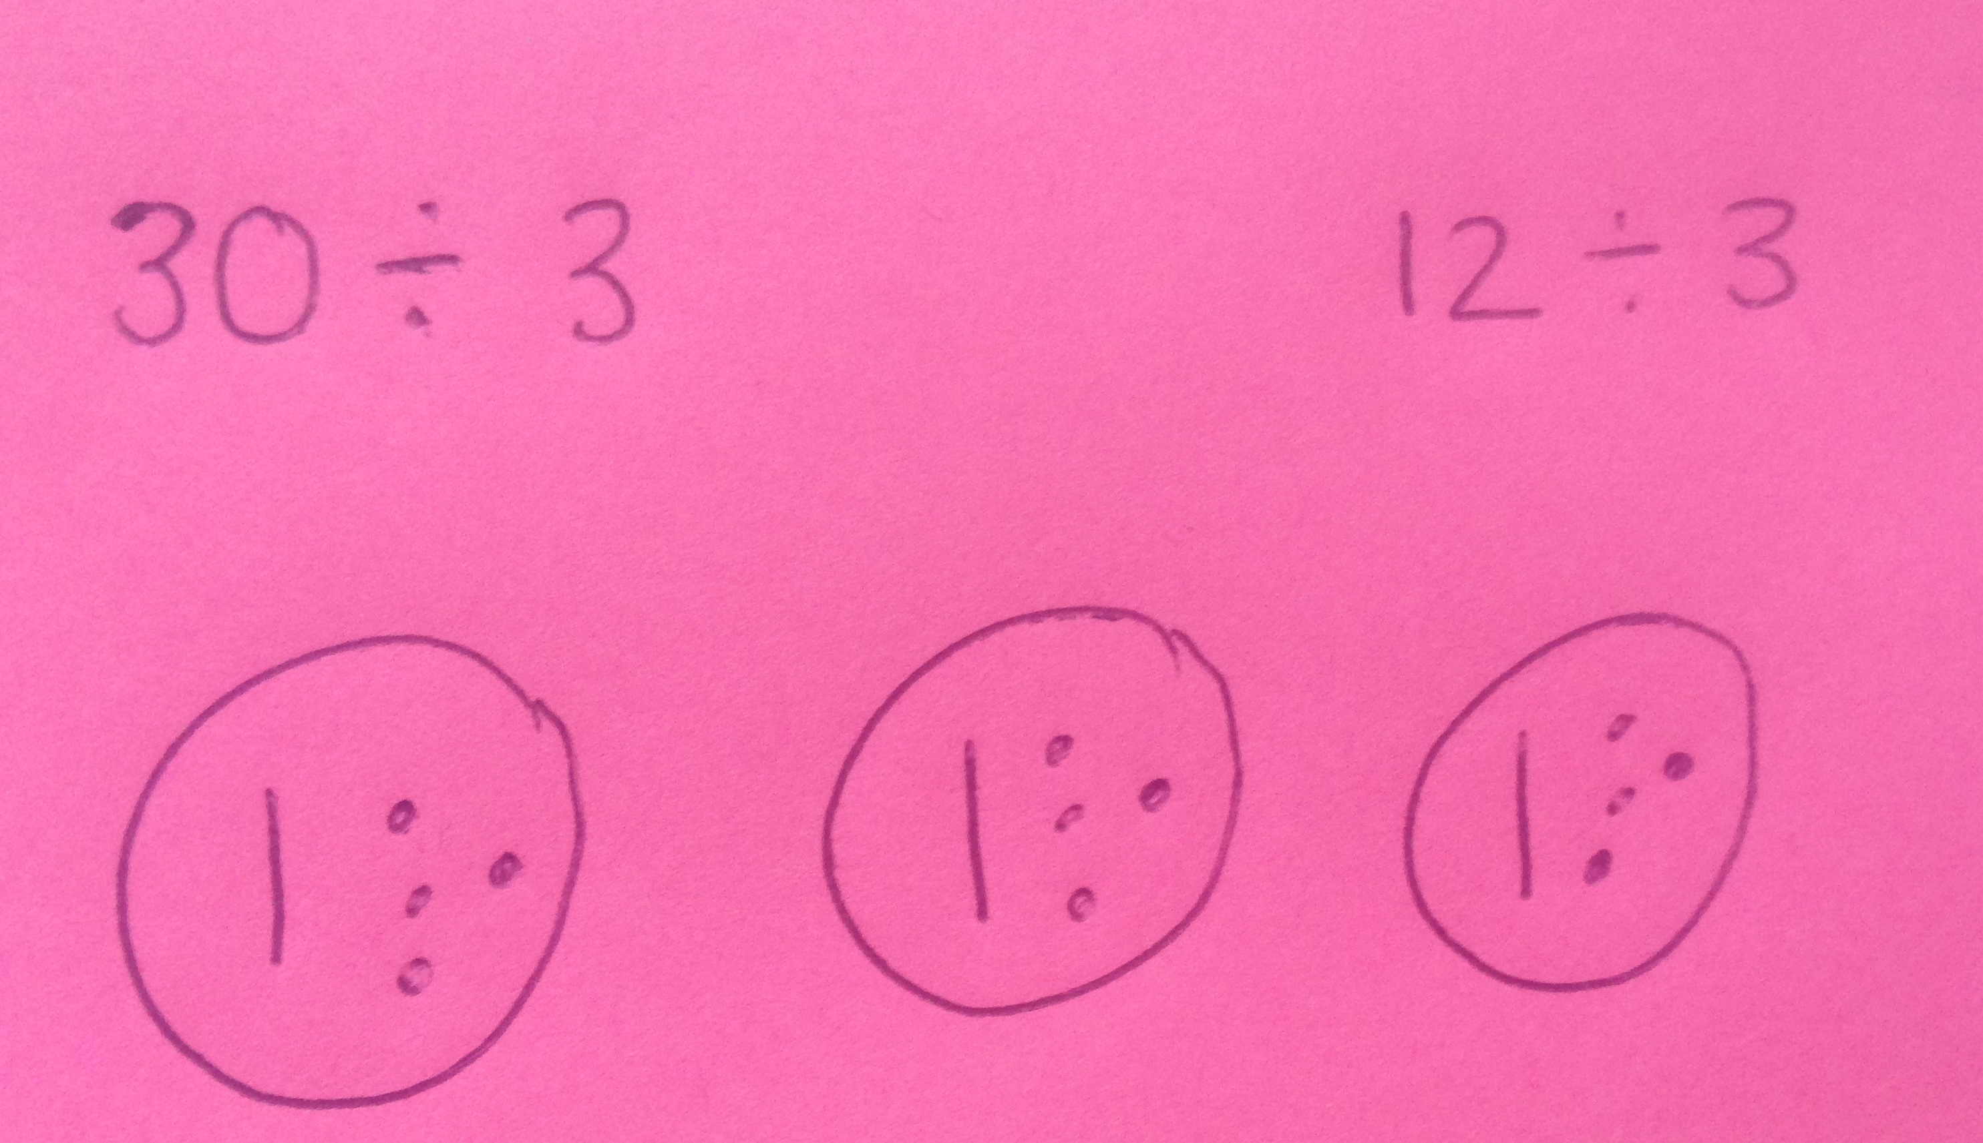
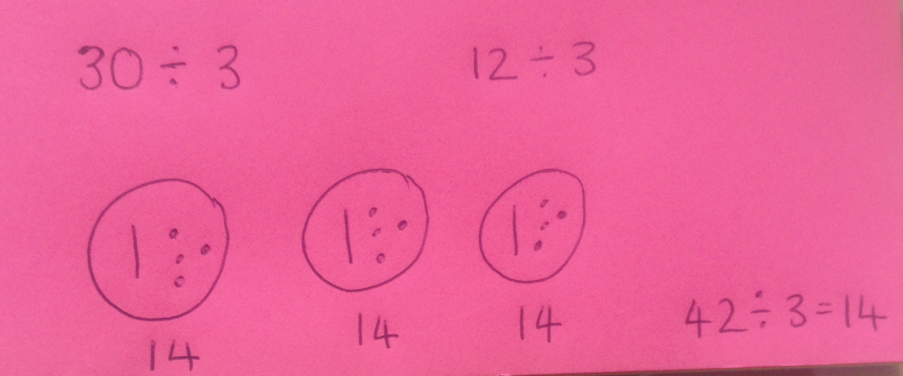
Today we are going to divide using regrouping. Let’s try 42 ÷ 3=
The divisor is 3.
Step 1: Partition the two digit number into tens and ones and draw them.
Step 2: Regroup one of the tens into the ones.
Step 3: Share the tens and share the ones into the number of groups given by the divisor.
Step 4: Find the answer by counting the amount in one of the groups.

Slide 44
Use the same strategy to solve 52 ÷ 4 =
Step 1: Partition the two digit number into tens and ones and draw them.
Step 2: Regroup one of the tens into the ones.
Step 3: Share the tens and share the ones into the number of groups given by the divisor.
Step 4: Find the answer by counting the amount in one of the groups.

Slide 45
52 ÷ 4 =
13

Slide 48
Now choose a challenge that is right for you and complete it. Most of you should do Challenge 2:

Slide 49
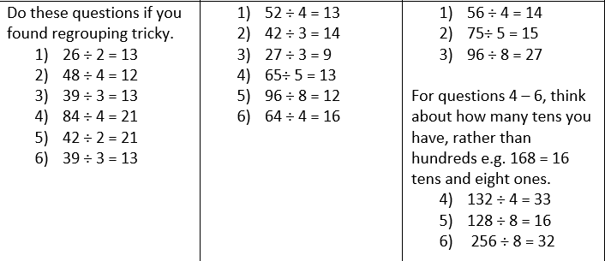
Here are the answers. Mark your own work!

Slide 50
You can do it! Use your Growth Mindset!

