Slide 1
Day 1- Monday 20th April 2020
L.O: To be able to answer comprehension questions about poetry

Slide 2
Dragonfly Out in the Sun by David Windle
I am a dragonfly and I live on the breeze, between the reeds and rushes and the sun’s soft fingers. I am a dragonfly and my wings are like water, or as sharp as two swords cutting the air into pieces. I am a dragonfly and my eyes are like glass, as round as the moon they see all that pass.
I am a dragonfly and my body’s a spear; as sharp as an eagle I hunt for my prey. I am a dragonfly and I float like a dancer over the pond’s still surface, which reflects, like a mirror, my miraculous presence. Do you know how I feel?

Slide 3
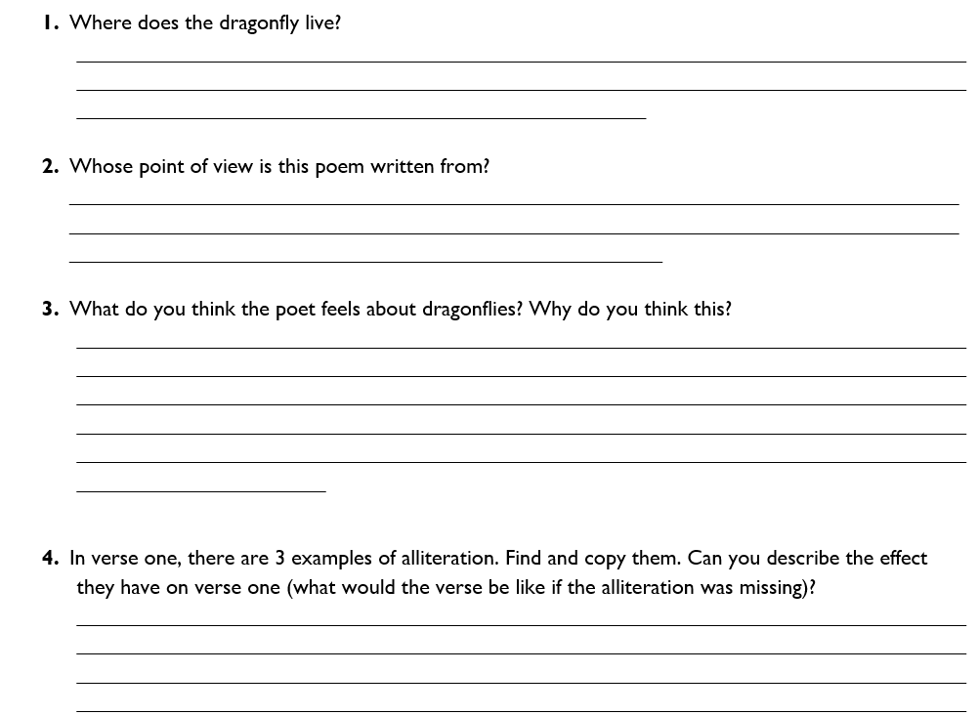
Comprehension questions

Slide 4
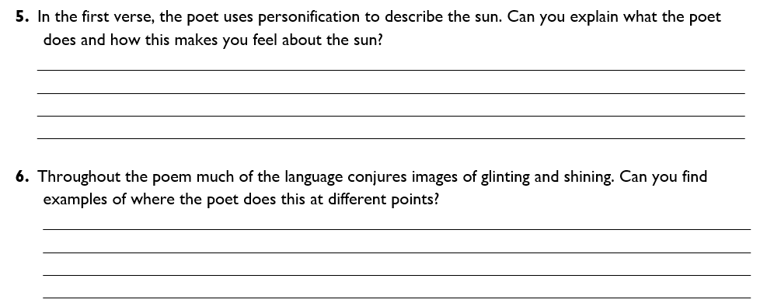
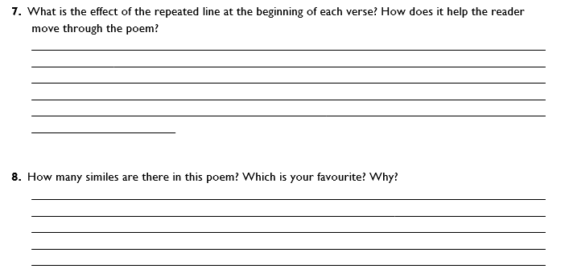

Slide 5
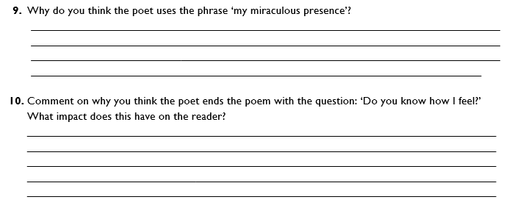

Slide 6
Day 2 – Tuesday 21st April 2020
L.O: To understand what features are used on poetry

Slide 7
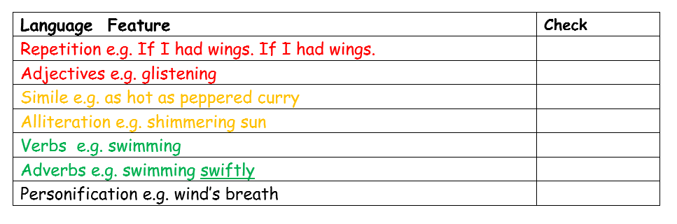
Watch https://www.youtube.com/watch?v=RCkM-IJew3Q with your child.
Language features of poems

Slide 8
Simile
A simile says things are like each other
E.g. as big as an elephant
red like the sun
as quiet as a mouse
Rhyme
Words with similar sounds
E.g. Cats sleep anywhere,
Any table, any chair
Personification
Makes something which isn’t alive seem
as if it is
E.g. The daffodils nodded their yellow heads
Alliteration
Two or more words starting with
the same sound
E.g. The whispering wind whisked past my ear

Slide 9
Rhythm
Based on the number of syllables in a line
E.g. The other team won, (5)
They all shouted ‘Hooray!’ (6)
I couldn’t believe it, (6)
It wasn’t our day! (5)
Onomatopoeia
When a word sounds like the noise it is
Describing
E.g. The rockets whooshed skywards
Repetition
Where the writer repeats a word or a
phrase to create an effect
E.g. Mine is the howl…
Mine is the nose…
Mine is the fur…
Metaphor
Where the writer writes about something
as if it were really something else
E.g. My feet were blocks of ice

Slide 10
Choose 2 or 3 of the features and make your own sentences for them.
Example –
Simile – Her lips were as red as berries or her lips were red like berries.
Personification – The long grass danced in the wind.
Alliteration - The tremendously, tall tree towered over me.

Slide 11
Day 3 – Wednesday 22nd April 2020
L.O: To identify features of a poem.

Slide 12
Listen carefully…
Watch https://www.youtube.com/watch?v=RCkM-IJew3Q with your child.
See if you can tick any of these features off the check list as you listen to the poems

Slide 13
Was is easier to identify the features by listening to the poem or reading the poem? Why?
Read this poem
See if you can tick any of these features off the check list.
The School Kid’s Rap by John Foster
Miss was at the blackboard writing with her chalk
When suddenly she stopped in the middle of her talk
She snapped her fingers, snap! snap! snap!
Pay attention children and I’ll teach you how to rap.
She picked up her a pencil, she started to tap,
All together children, now clap! clap! clap!
Just get the rhythm, just get the beat
Drum it with your fingers, stamp it with your feet.
That’s right children, keep in time,
Now we got the rhythm, all we need is the rhyme
This school is cool, the teacher is ace,
Strut your stuff with a smile on your face.
Snap those fingers, tap those toes,
Do it like they do on the video shows,
Flap it! Slap It! Clap! Snap! Clap
Let’s all do the school kids’ rap!

Slide 14
Day 4 – Thursday 23rd April 2020
L.O: To memorise a poem

Slide 15
Listen or read the following 3 poems: -
Pirates
The night was as dark as an inkwell,
For the moon had gone visiting elsewhere,
But by the scuffling sounds around me,
I knew there was someone there.
By the grunt and the groan and the muffled shout,
I knew there was someone else about.
I knew he had come here to rob me,
Take my silver, my jewels and gold,
In the dark I had the advantage,
It was as if he had a blindfold,
But I was fine, knew the lay of the land,
Each bit as familiar as the back of my hand.
He was caught in the second trap I'd set,
I heard him yelp with the pain,
But he was getting closer,
And I reached for my weapon again,
I was willing to die for what was mine,
Ready to strike if he crossed the line.
So I stood there over my treasure,
On the X which marked the spot,
Then suddenly he was behind me,
My stomach twisted into a knot.
Then Dad came in, turned on the light,
Said, "Time to stop playing. Sleep well. Good night.!

Slide 16
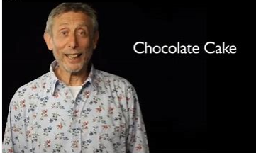
Watch Michael Rosen's performance of chocolate cake together
The schoolkids rap
That’s right children, keep in time,
Now we got the rhythm, all we need is the rhyme
This school is cool, the teacher is ace,
Strut your stuff with a smile on your face.
Snap those fingers, tap those toes,
Do it like they do on the video shows,
Flap it! Slap It! Clap! Snap! Clap
Let’s all do the school kids’ rap!
That’s right children, keep in time,
Now we got the rhythm, all we need is the rhyme
This school is cool, the teacher is ace,
Strut your stuff with a smile on your face.
Snap those fingers, tap those toes,
Do it like they do on the video shows,
Flap it! Slap It! Clap! Snap! Clap
Let’s all do the school kids’ rap!
https://www.youtube.com/watch?v=7BxQLITdOOc

Slide 17
Take your time to practise one the following poems off by heart without looking.
Think about your voice – project your voice.
Think about your tone and expression.

Slide 18
Day 5 – Friday 24th April 2020
L.O: To perform a poem for an audience

Slide 19
Record your child’s performance and email it to us on: learning@wembleyprimary.brent.sch.uk
How did you do?
What do you think went well?
What could you improve?

