Slide 2
During the next few lessons you will be learning about the topic Take Care.
You are going to be thinking about things you do to look after yourself.
How do your parents/carers keep you safe?
What dangers are there in the house?
How do you keep yourselves safe?
What do you need to remember when you are outside?
Discuss your ideas with someone at home!

Slide 3
THINK!
THINK!
THINK!
How do you stay healthy?
Talk to someone and write your ideas down.
Now let's have a look at a day in Blobble's life. -->

Slide 4
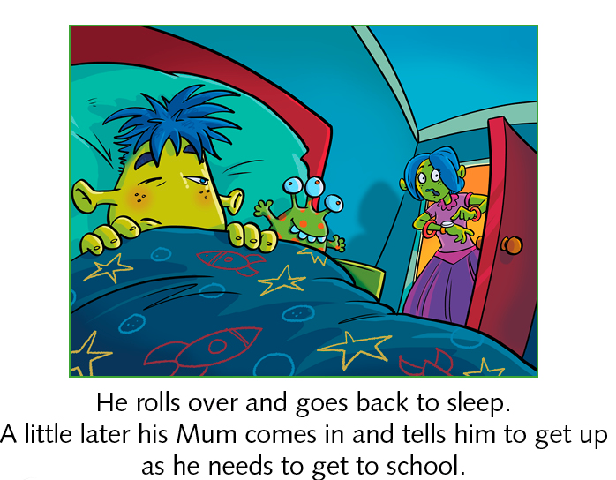
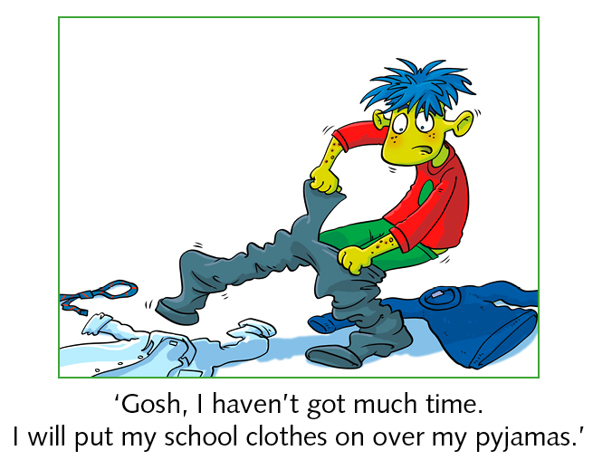
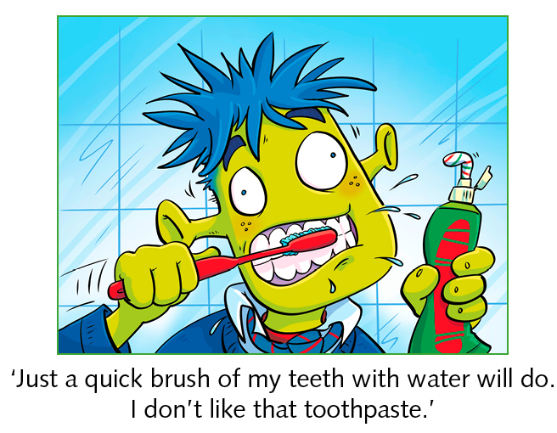
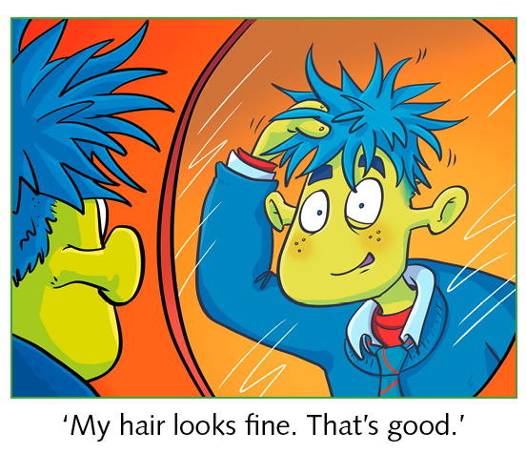
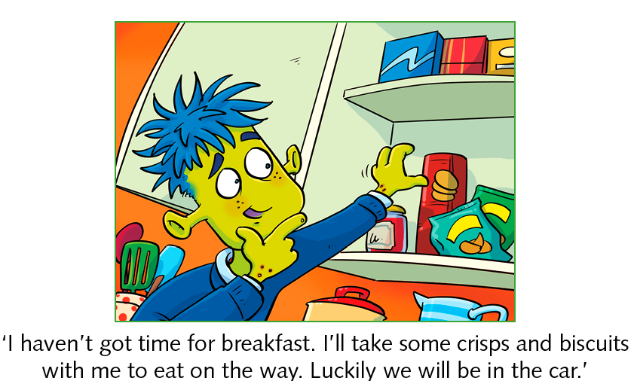
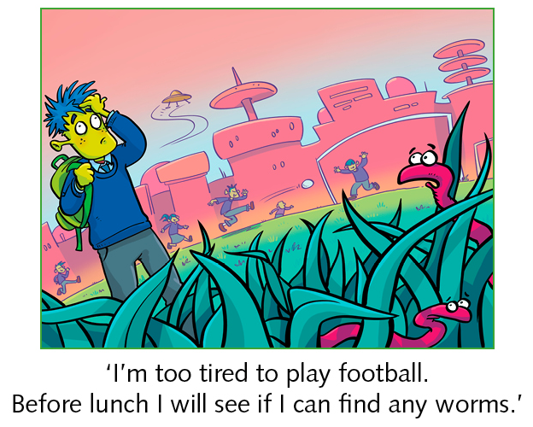
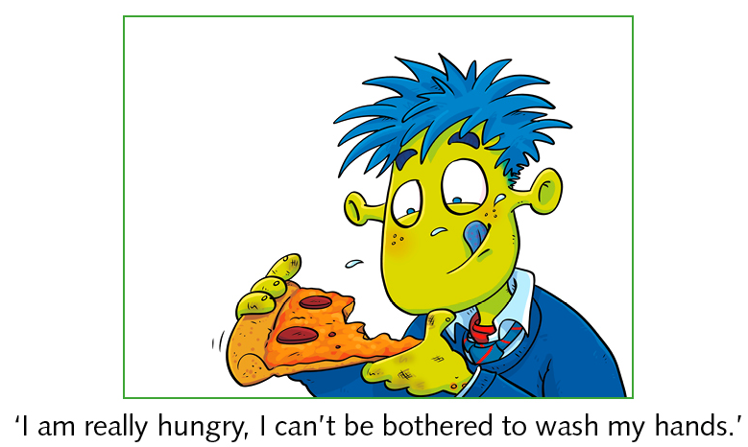
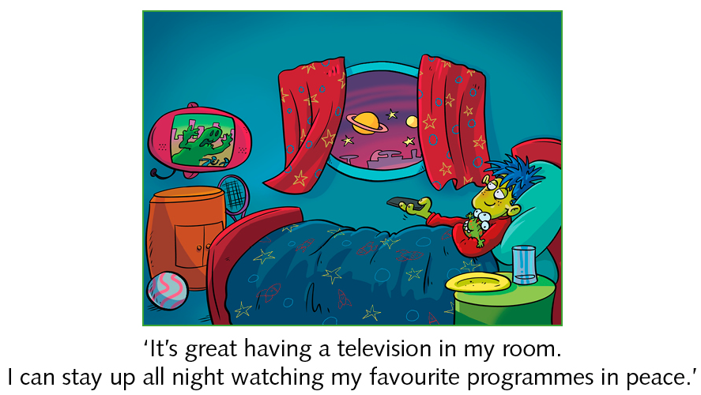
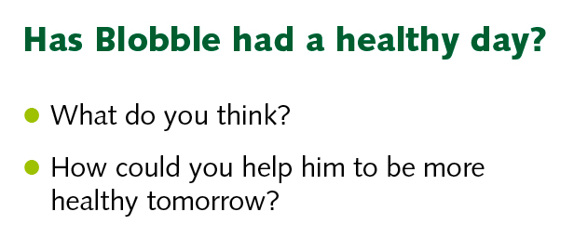

Slide 5
THINK!
Our key question that we will answer today is:
THINK!
THINK!
How can we sort food?
L.O: To sort food into different types.
I can suggest ways to group the foods.
I can give reasons why I have grouped them in this way.
I can draw a table to show my groups.

Slide 6
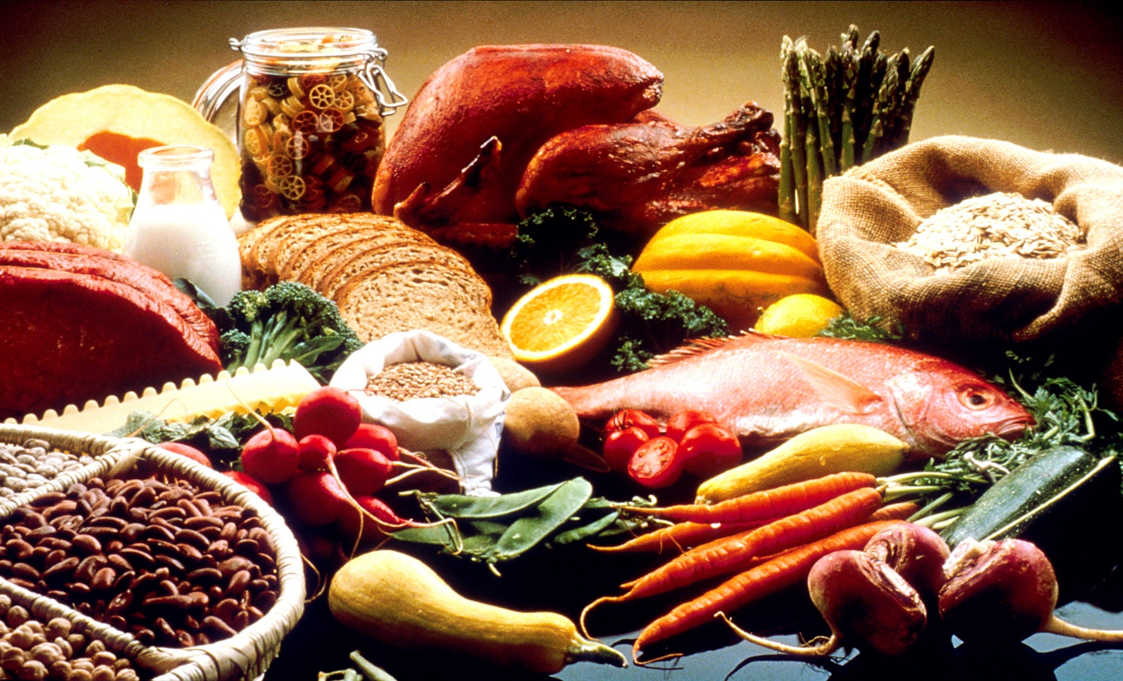
What ways can we sort food?
THINK!
THINK!
THINK!
Hopefully you have thought of some different ideas! You could group them by how they feel, look, smell and taste.
Are there any other ways you can group food?

Slide 7
What ways can we sort food?
THINK!
THINK!
THINK!
You could group them by their food types! There are 5 different food types. Can you name any of them? Write them down!

Slide 8
Here are the 5 main food groups:
Carbohydrates
Proteins
Dairy
Fruit and Vegetables
Fats, oils and Sugars
Did you guess any of them?
What foods can you think of for each group?

Slide 9
Now watch this videos about the food types:
https://www.bbc.co.uk/bitesize/clips/z3n2tfr

Slide 10
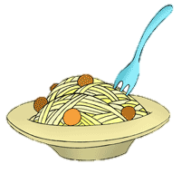
Carbohydrates…
These are foods such as bread, potatoes, spaghetti and cereals.
They give us steady energy and keep us full up.
The energy is easy for our bodies to use, so lots of athletes eat carbohydrates before races and training.

Slide 11
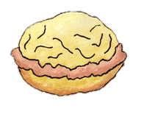
Proteins…
These are foods such as meats, beans, fish,
eggs and pulses.
They help our bodies grow and repair themselves.

Slide 12
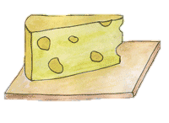
Dairy…
Milk, cheese, yoghurt and creams are types of dairy foods.
Dairy provides calcium.
Your body needs calcium to help keep bones and teeth strong and healthy.

Slide 13
Fruit and Vegetables…
Foods like apples, bananas, strawberries and oranges are fruits.
Carrots, beans, peas, broccoli and cauliflower are vegetables.
Fruit and vegetables provide fibre and vitamins.

Slide 14
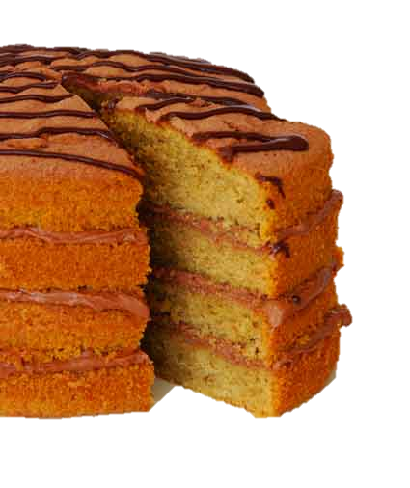
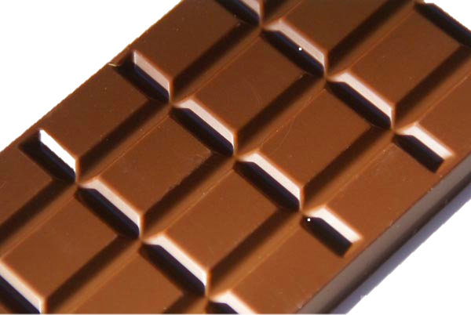
Fats, oils and sugars…
These can include oils such as vegetable oil, olive oil and
Sunflower oil.
Fats and sugars include chocolates, biscuits, sweets and cakes.
Fats and sugars help provide energy.

Slide 15
Skills Activity
Look at the worksheet Science Skills - Sorting foods. Sort as many of the foods as you can into the 3 food groups. You can do this by drawing pictures or writing the names of the food in the correct column.
Carbohydrates | Proteins | Fruit and vegetable

Slide 16
Core and Extension
Activity 1
Look at the worksheet Science Core and Ext - Sorting foods.
Draw a table and sort as many of the foods as you can into the 5 food groups. You can do this by writing the names of each food in the right column.
Give each column a heading.

Slide 17
Plenary
Final question:
Why do you think sorting foods might help us to be healthy?

