Slide 1
How does your garden grow?
What do you think it is about?

Slide 2
Key words
plant, roots, stem, trunk, leaf/leaves, flower, leaflet, stalk, veins,
surface, edge, lobes, tip, food, root hair, nutrients, seed, germination, seedling, growth, mature plant, flowering, pollination, bud, petal, sepal, carpel, stamen, pollen, reproduce, nectar, seed, fruit,
wind, water, air, light, stigma, style, ovary, anther, filament,

Slide 3
Think about the following questions
What do plants need to grow?
How do plants get nutrition?
What are the different parts of a plant?
Why do plants have leaves?

Slide 4
What do all plants have in common?

Slide 5
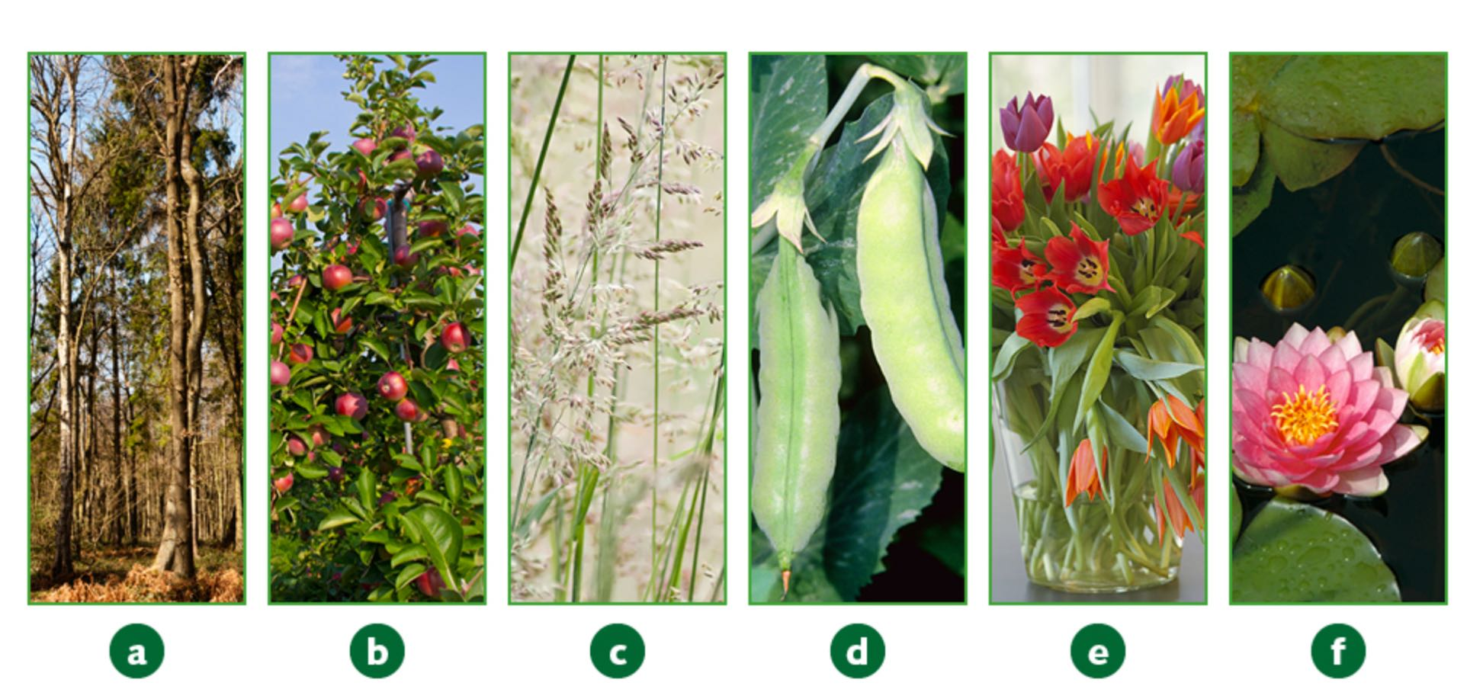
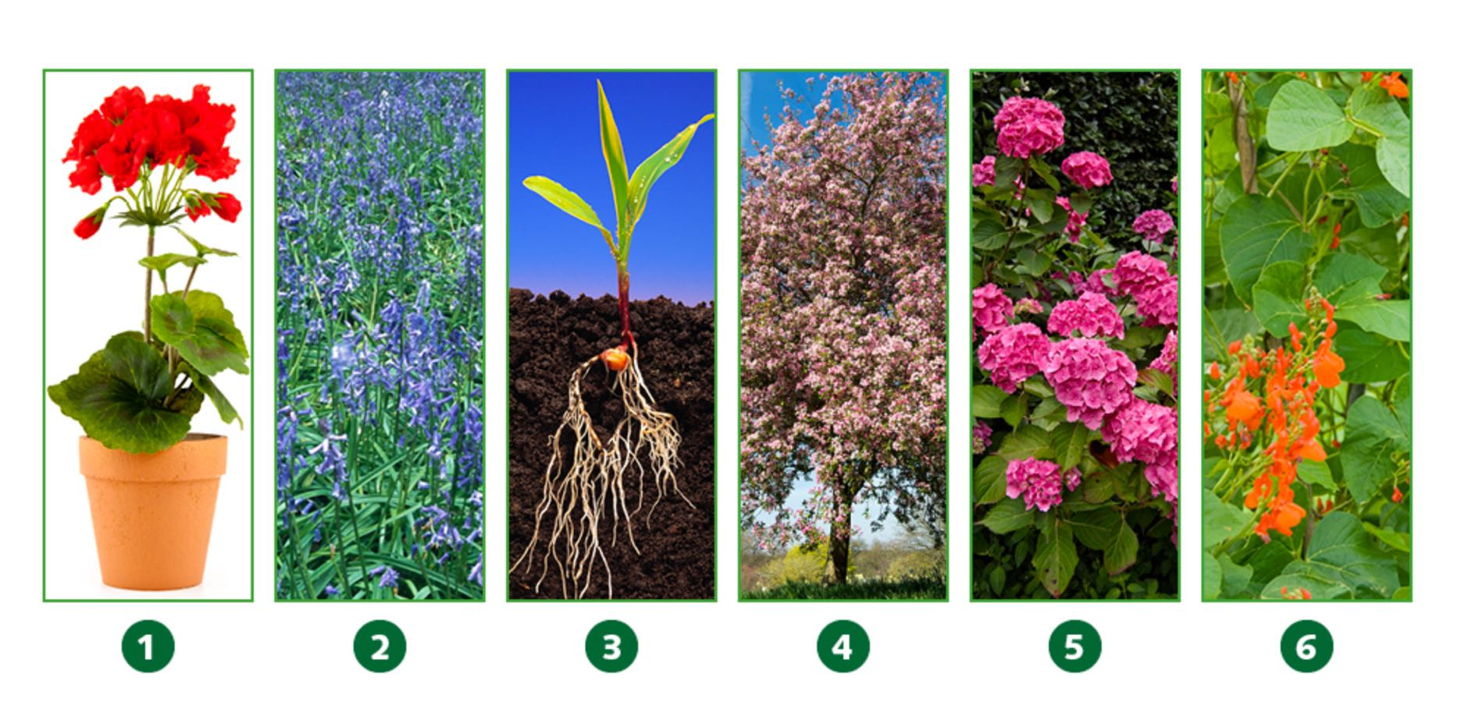
What are the differences between them?

Slide 6
What do plants need to grow?

Slide 7
What question could you investigate about these plants?

Slide 8
Can you name the different parts of a plant?

Slide 10
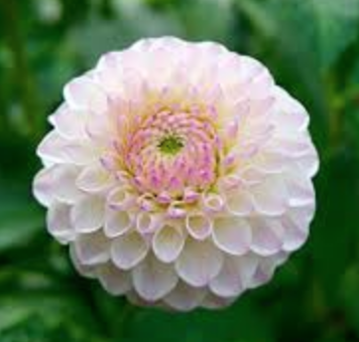
flowers
Plants produce flowers to make seeds.
The flower petals are usually bright to attract insects especially bees.
Flowers need bees to pollinate them.

Slide 11
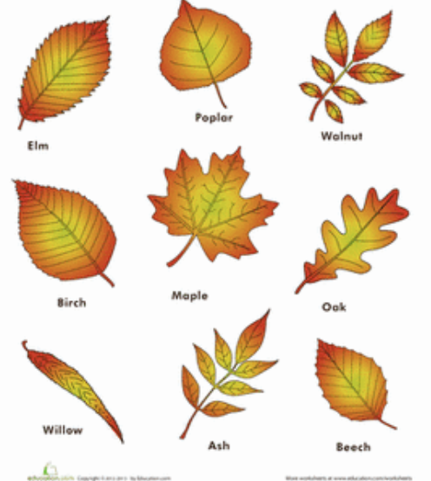
Leaf/Leaves
The leaves of a plant make food.
The leaves use sunlight to make food for the plant to use.
This is called photosynthesis.
Plants also breath through these leaves.
They take in carbon dioxide and give out oxygen.
We breath in this oxygen, that is why we need to grow lots of plants.

Slide 12
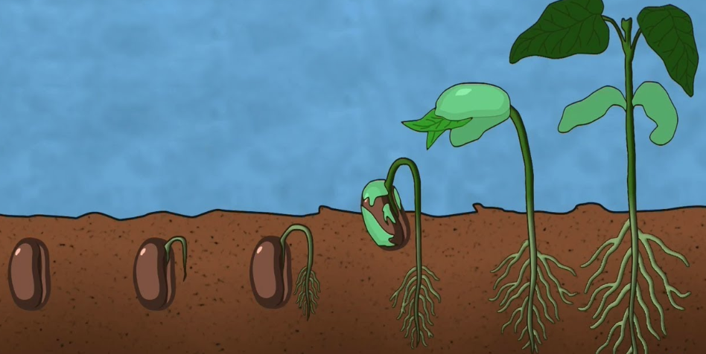
Seeds
Seeds are produced by a plant so that it can grow into a new plant somewhere different.
Seeds need to be given water and nutrients so that it can grow into a plant.

Slide 13
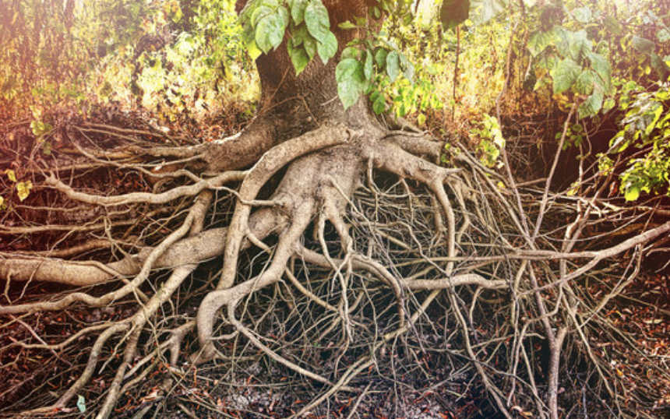
Roots
Roots are used to anchor the plant in the soil.
The roots also absorb water and minerals from the ground to help the plant grow.

Slide 14
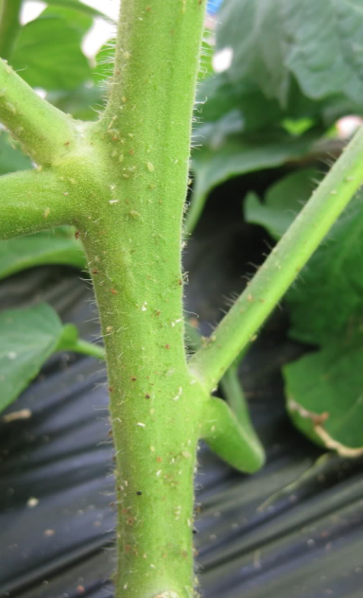
Stem
The stem of a plant gives it support and holds it upright.
It also keeps the leaves in the upright position so that it can have lots of sunlight.
Another job of the stem is to carry food and water from the roots to other parts of the plant.

Slide 15
Useful videos to watch
https://www.bbc.co.uk/bitesize/topics/zy66fg8/articles/zcjnp39
https://www.bbc.co.uk/bitesize/topics/zy66fg8/articles/zcmtk2p
https://www.bbc.co.uk/bitesize/clips/z9f87hv

Slide 16
Task
Take photos of plants in your garden. Are they all the same? How are they similar? How are they different?
Draw a diagram of a flowering plant.
Label all the parts of the plant.
Choose 3 parts of the plant and write what it does.

