Slide 1
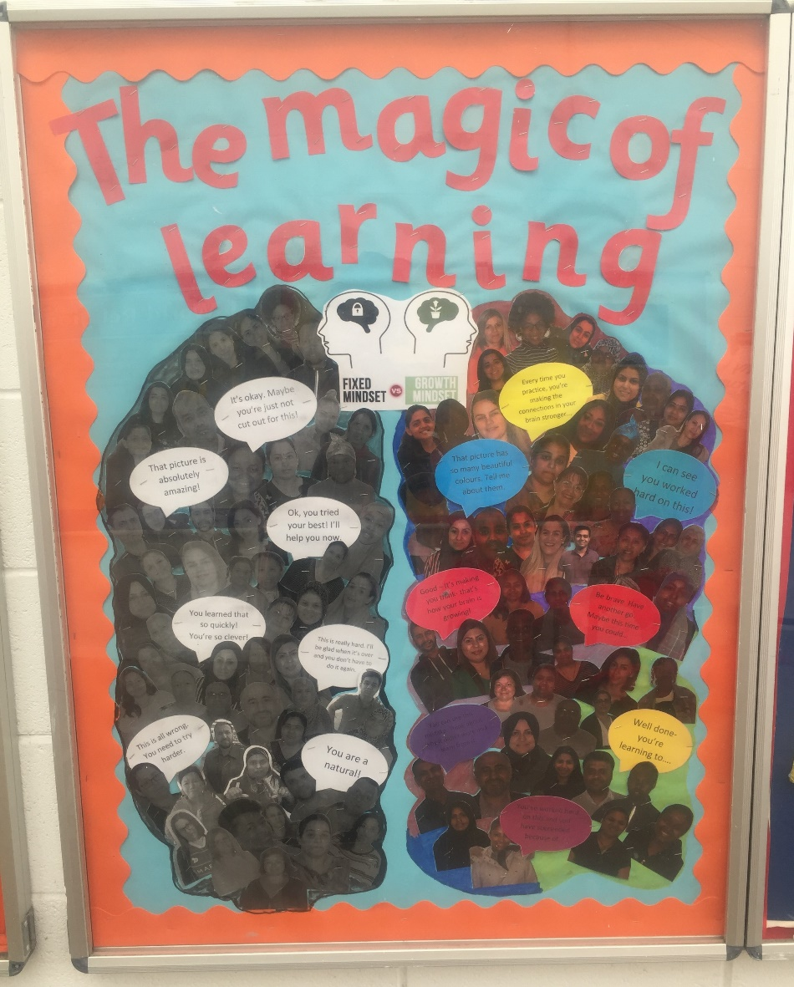
The magic of learning…
An introduction to Growth Mindset…

Slide 2
Aims
To understand the concept of growth mindset.
To understand how this benefits children’s learning.
To understand how to support your child at home to develop a growth mindset.

Slide 3
What are your experiences of learning?
Think about…
Your teachers….
Your classrooms…
How you were taught…
How did you learn?

Slide 4
Think about…
Classroom layout…
Curriculum…
Interaction with others…
What do you think good learning looks like?

Slide 5
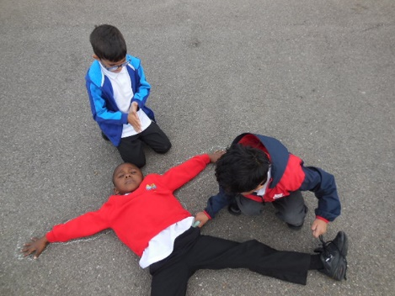
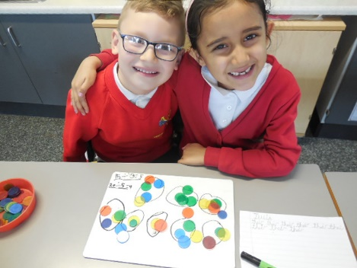
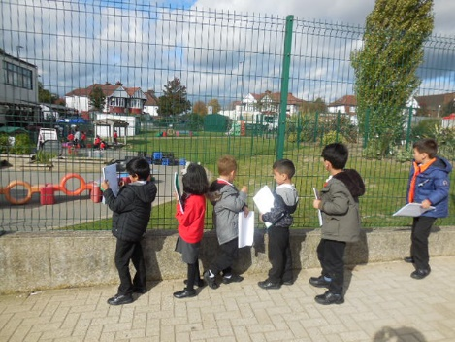
What good learning looks like at Wembley Primary School
Learning through collaboration
Respecting one another
Learning from our mistakes and celebrating our mistakes
Taking risks – leaving your comfort zone
Safe environment
Using all feedback

Slide 6
Notes:
Active learning
Copying
Scaffolding
Everything else

Slide 7
‘Growth Mindset’
Benefits for both adults and children in an ever-changing world.
Builds resilience and a desire to learn.
Enables learners to challenge themselves.
Encourages a culture of collaborative learning.
Raises standards.
Raises aspiration and allows achievement of our full potential.
Notes:
Coping strategy – how you cope with not giving up/challenges in the real world – not always where you want to be

Slide 8
The Magic Of Learning
Notes:
Start 10 stop 1.48

Slide 9
Times tables – repetition of knowledge.
New experiences- putting learning into context.
Compare learning from before and after
Show that learning never stops- even adults still learn!
What can you do at home to help brain muscles and neurons to grow?
Notes:
Mistakes before and after
Spelling
Celebrate your own progress

Slide 10
Making Comparisons
Notes:
Learn at different paces
All at different stages in our learning – best not to compare to others

Slide 11
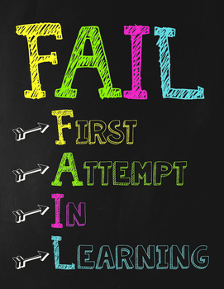
Mistakes – does not mean you have failed!
Notes:
, building on first attempts, bricks example, building on first mistakes like building blocks
score

Slide 12
Notes:
1.48 video stop at 2.29

Slide 13
What situations could make children’s brains shrink?
Stop practising
Not trying new experiences, avoiding situations that may lead to failure
Giving up
Seeing mistakes as a negative learning experience
Trying the same learning repeatedly rather than taking risks and challenging themselves
Comparing themselves to others
Threatened by feedback

Slide 14
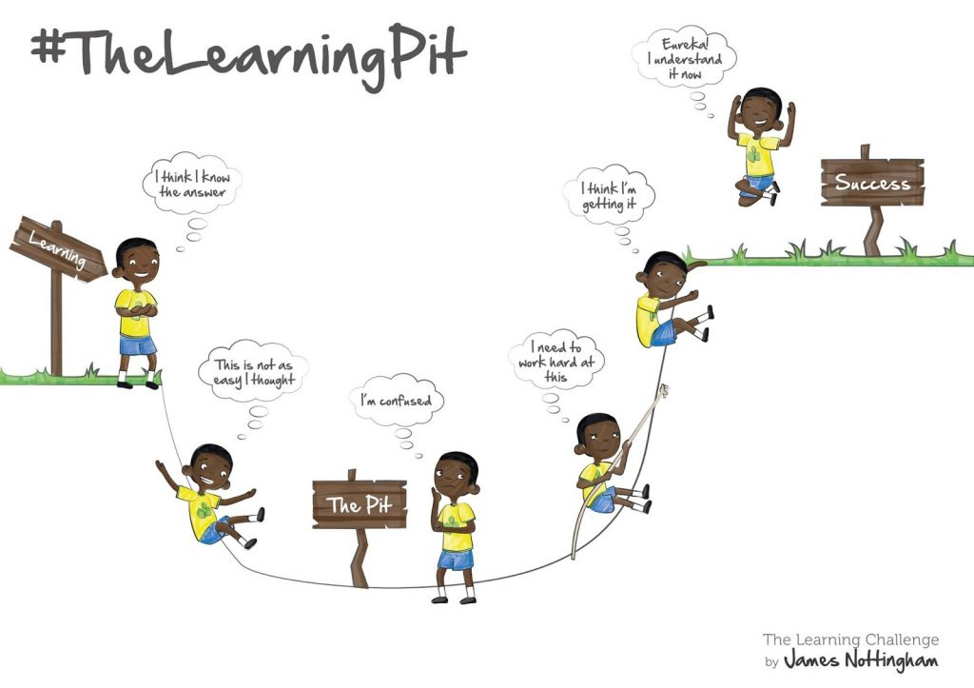
How growth mindset is used at WPS?
Notes:
Language used at school
Choice challenge

Slide 15
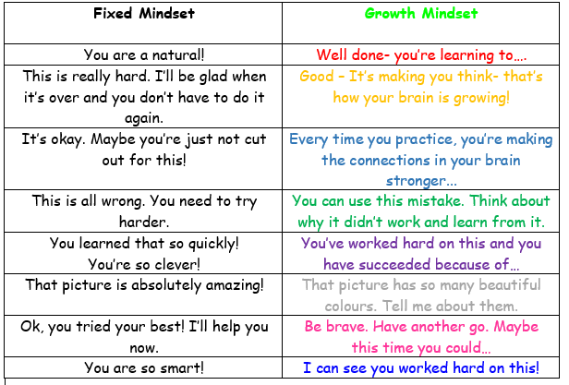
How you can help at home?

Slide 16
How you can help at home?
I am giving you this feedback because I believe in you!
Notes:
Feedback, scores

Slide 17
