Slide 1
Meet the teacher 2023-24
5W and 5P
Ms Tobutt and Ms Shah
Notes:
Sharon

Slide 2
The online world
There are lots of positives:
Teamwork and creativity
Knowledge
Socialisation
But there are negatives too:
Sleep cycles
Attention span
Online risks
Notes:
Eleanor

Slide 3
The 4 Cs of Online Safety
Content – What children see online
Contact – Who children talk to online
Conduct – How children behave online
Commerce (or contract) – Advertising, marketing, scams etc.
Notes:
Eleanor

Slide 4
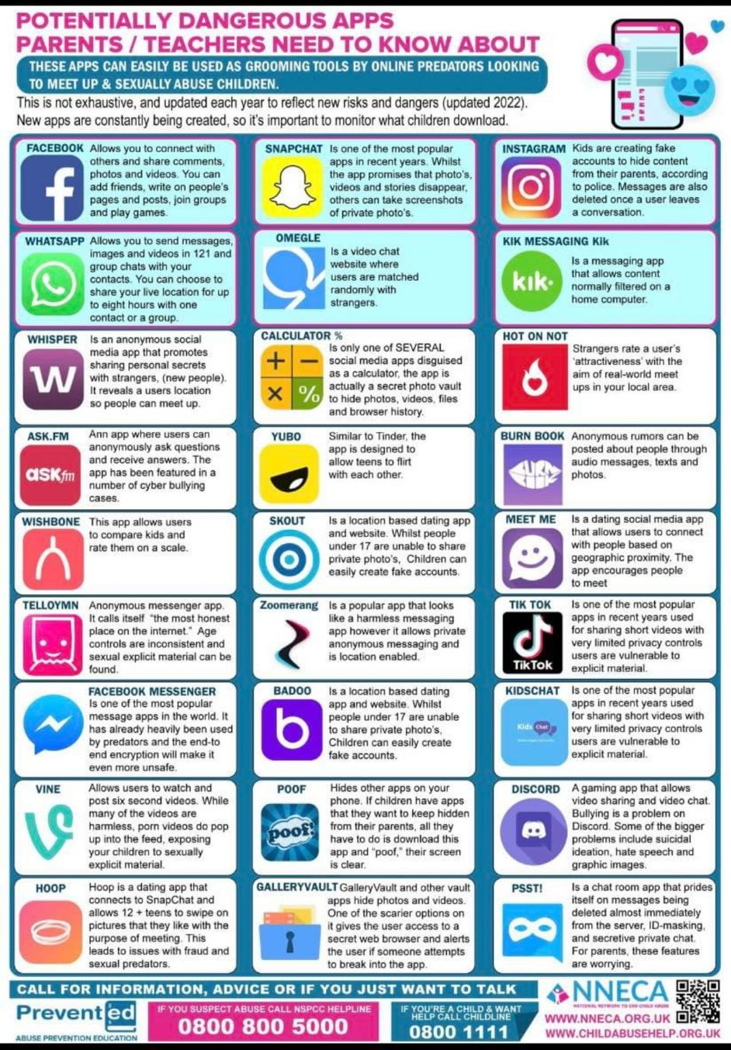
Online Safety
Understand the risks but keep them in proportion.
Communicate regularly – what are they doing, who are they talking to
Ensure the apps they are using are age-appropriate.
Develop strategies with you children
You are the parent, having a device is a privilege not a right.
Notes:
Eleanor

Slide 5
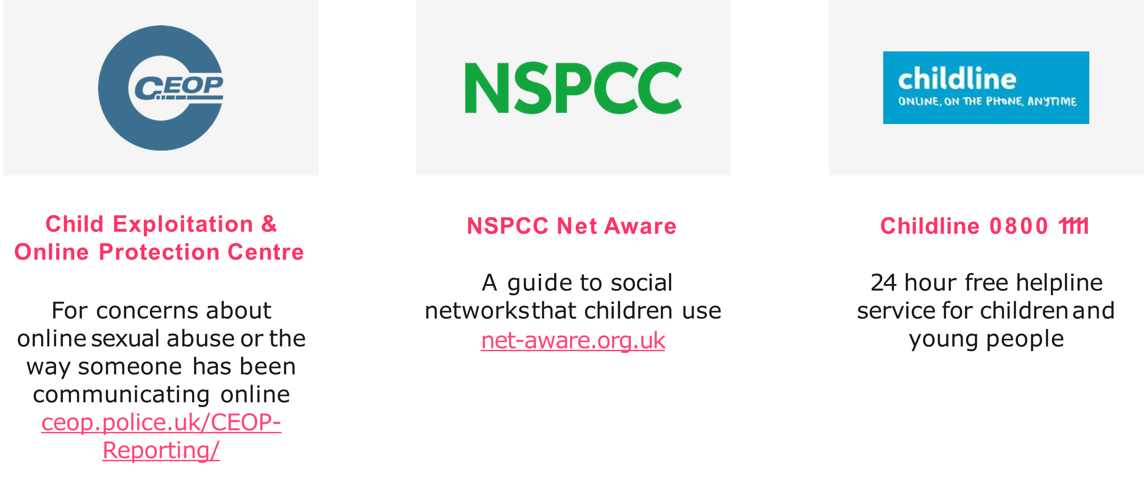
Resources
Internet matters
Full of useful information for parents. Including parental controls and privacy settings.
internetmatters.org
Notes:
Eleanor

Slide 6
Personal Details
Ensure the office has up-to-date details for your child.
Address
Emergency contact numbers – two numbers needed
Email address
Medical information
Notes:
Alpa

Slide 7
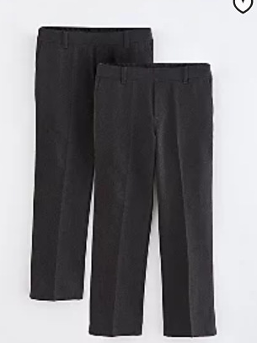
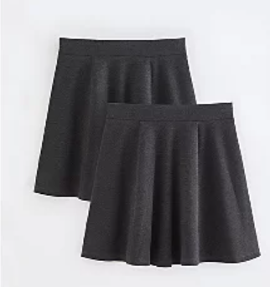
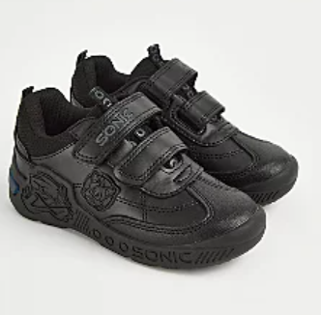
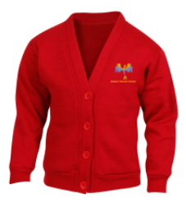
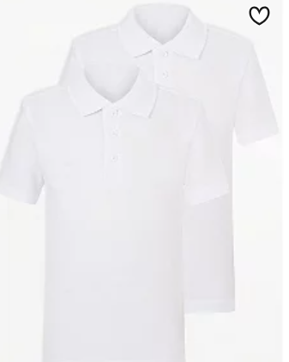
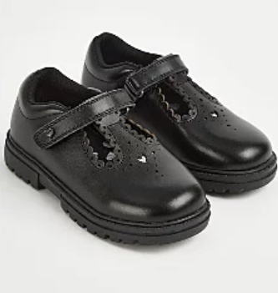
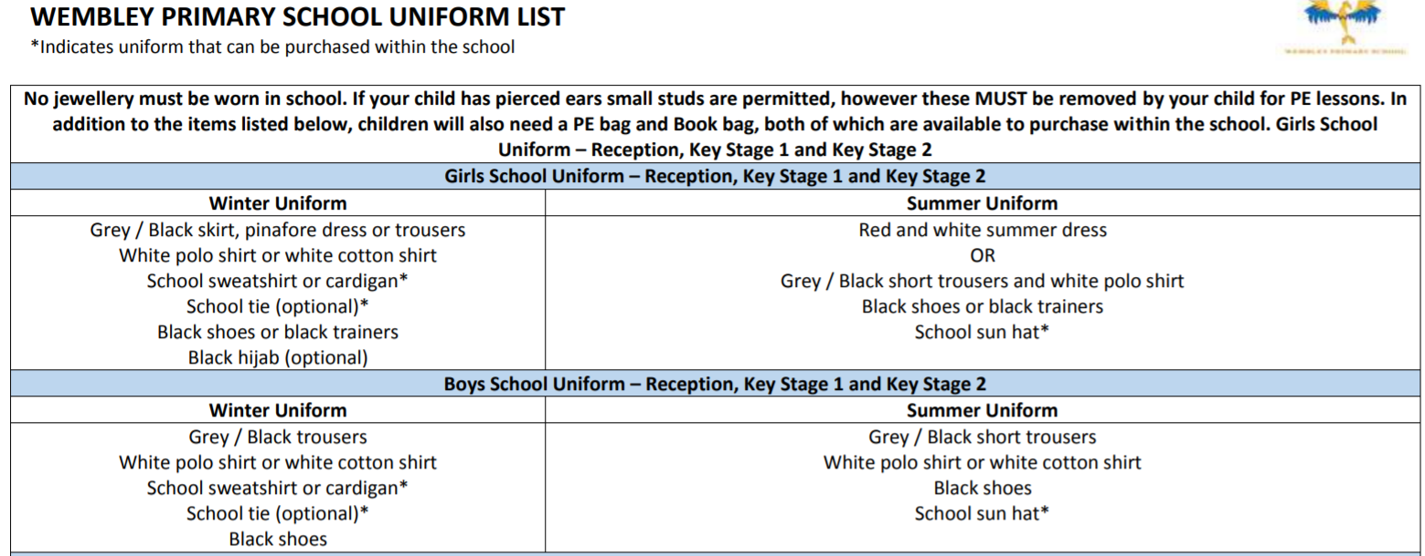
School Uniform
Notes:
Sharon Jewellery/hair accessories – red headbands

Slide 8
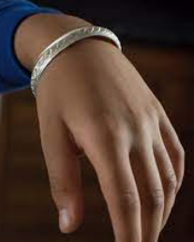
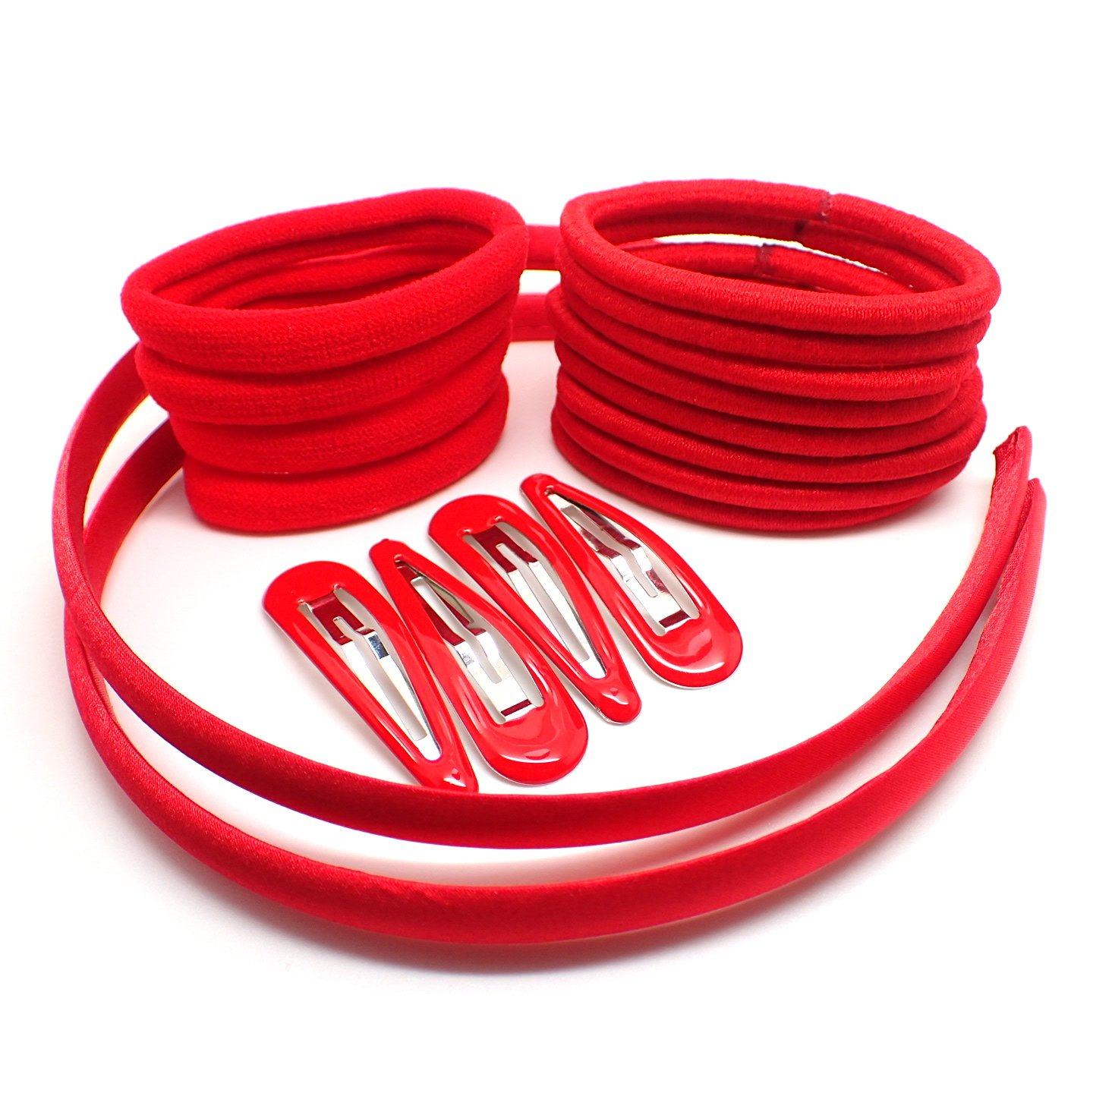
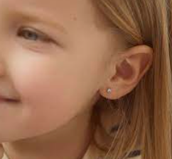
Jewellery
For safety, no jewellery is the best option.
We allow:
Compulsory religious jewellery
Red, simple hair accessories
Small studs
Notes:
Sharon

Slide 9
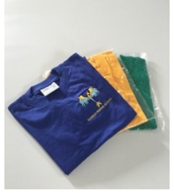
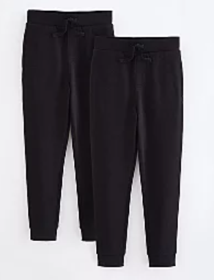
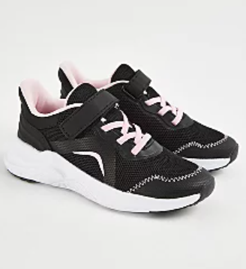
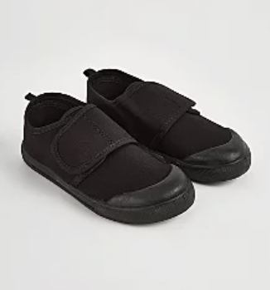
PE Uniform
No hoodies
No football tops
No blades or studs trainers
Notes:
Sharon

Slide 10
PE
PE lessons will take place every Wednesday and Thursday.
We cannot change for PE so on these days you will need to wear your PE kit to school.
House Team t-Shirt or white t-shirt
Black Jogging bottoms, leggings or shorts
Trainers
School jumper
Notes:
Alpa

Slide 11
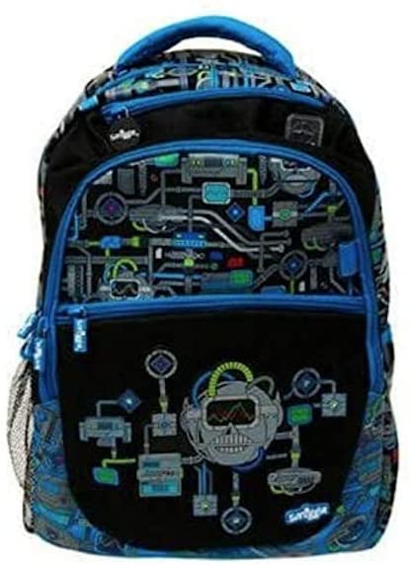
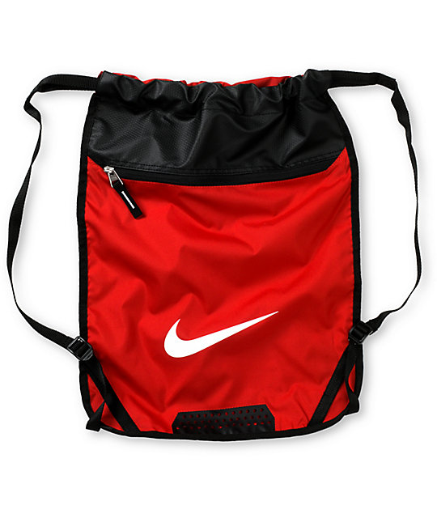
Things your child needs to bring
Do not bring a bulky back pack as we cannot use the cloakrooms to store items.
You will not be able to bring a pencil case from home, unless . All your equipment will be provided.
Bring a waterproof bag that can hold your home learning books (A4 size) and your reading book, which can fit on the back of your chair.
You may bring a labelled water bottle from home.
Healthy snack for break – fruit or vegetables only.
✓
✓
Notes:
Alpa

Slide 12
Attendance and Punctuality
It is vital that you come to school every day and on time.
Soft start begins at 8:35.
The register will close at 8.50
Please ensure you are collecting your children on time from the playground at 3.30.
Notes:
Alpa

Slide 13
Reading
You will be expected to read for at least 20/30 minutes every day. This should be a banded book.
An adult/children (Y5/6) need to be filling in their reading record every night with a summary of what they have read and any new vocabulary they have acquired.
Children’s book bands are determined upon performance in class and on assessments.
Reading Record example:
12/9/2023 Star Light p.5-25 | The impression I get of the witch is that she is old because ‘her withered hand’ Vital – extremely important Treacherous – very dangerous
Notes:
Sharon

Slide 14
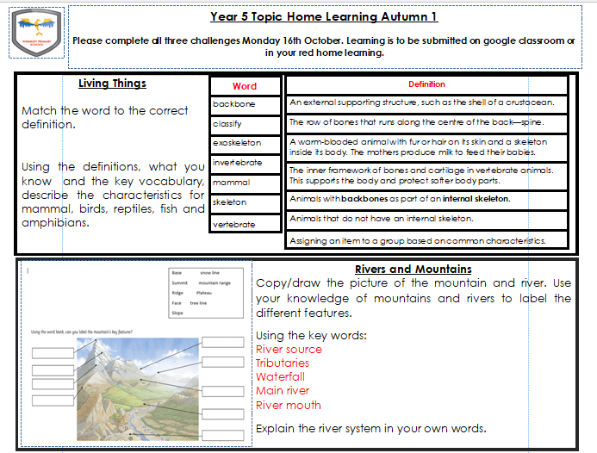
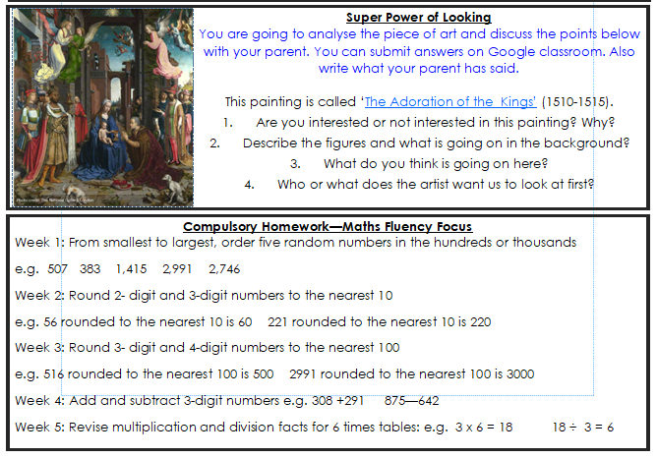
Home Learning
Reading – Banded Books
Home Learning Challenges all three to be completed by the last Monday of the half term.
Compulsory Maths – activities to complete in red homework book each week
Spellings – given out every Tuesday for a test on Friday
School website (click on link) https://www.wembleyprimary.co.uk/news/year-5/
Notes:
Sharon

Slide 15
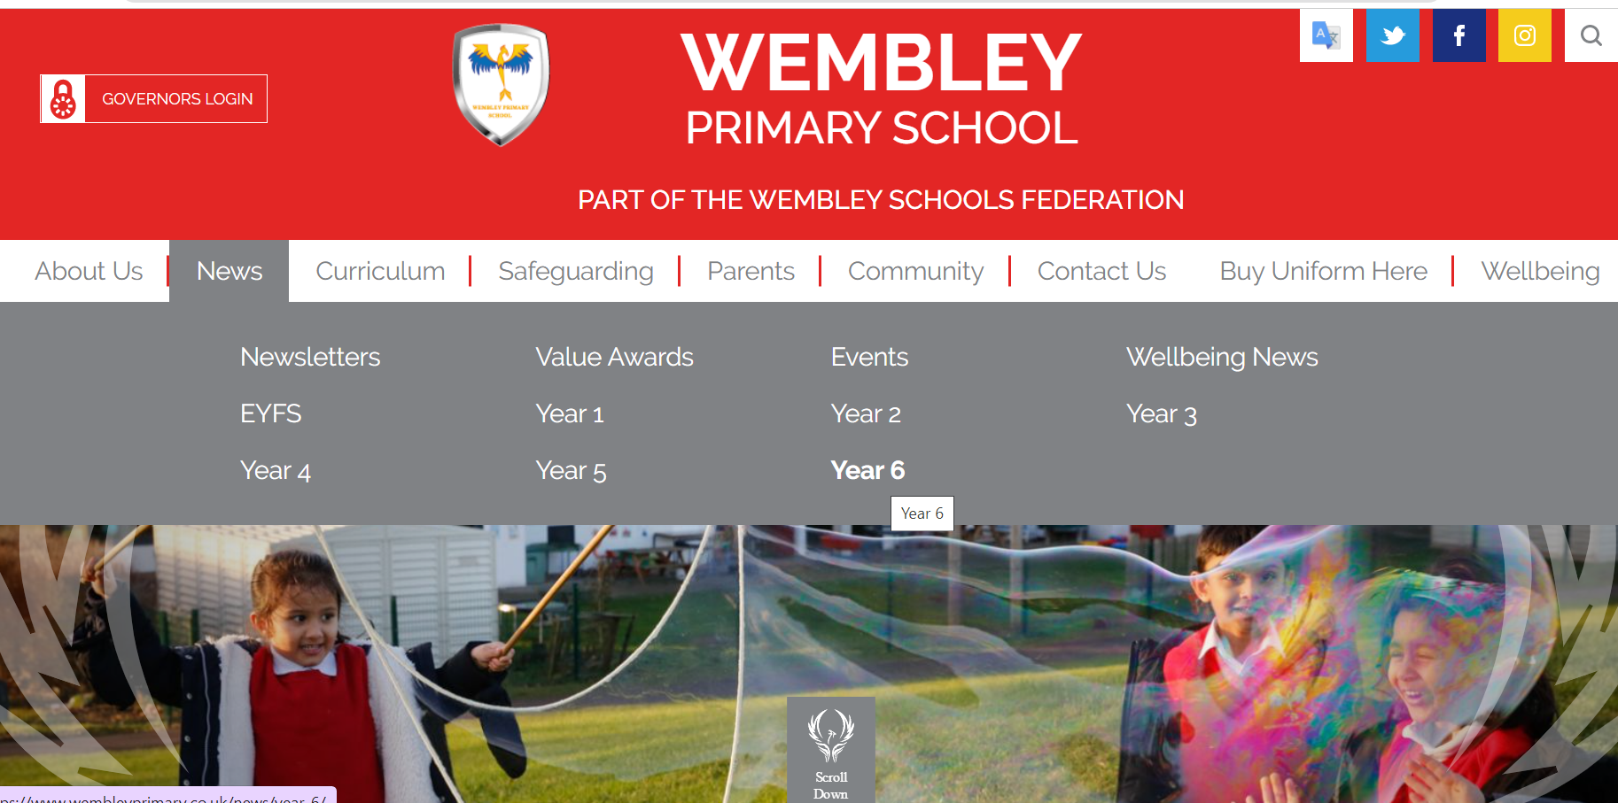
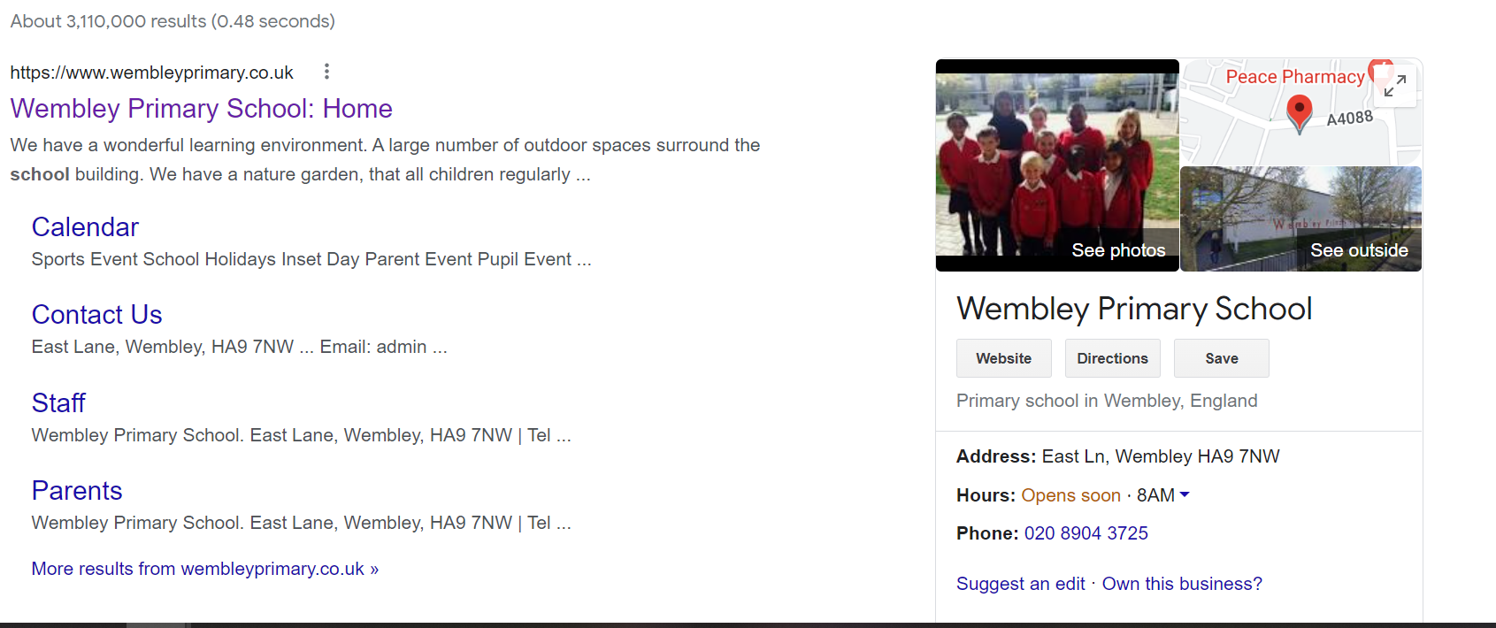
School website (click on link)any communication with children’s learning will appear on here
In addition please make sure your children are checking Google classrooms daily as learning and any notices will be put on there also.
Good idea for you to download the app onto your phone and log in as your child, so you get the notices too.
Notes:
Sharon

Slide 16
Making appointments to see your child’s teacher
If you need to discuss something brief with us please come and speak to us when you collect your child at the end of the day. If you are going to need a longer amount of time, then please arrange an appointment via the school office or with the teacher at collection time.
Appointments with a class teacher in a morning need to be before 8:30am. Teachers are in class with pupils from 8:35am during Soft Start.
Updating you on your children's progress – we will do this through our parents meeting and reports. If you have concerns then please do come and discuss with us.
Notes:
Sharon

Slide 17
After School Clubs
If a space is available, children will be given their 1st choice club then removed from any additional preferences
Waiting lists will be created if a club is over-subscribed and additional spaces if more adults are able to support. You will be contacted from the school office, if a place becomes available.
Invited clubs – you will receive a letter from a class teacher prior to clubs becoming available. This is a free club and will run for 8 weeks or more dependent on the teacher.
Notes:
Sharon
1. Aim to allow more children to attend a club rather than one pupil to attend multiple (fairness)

Slide 18
Trips
A parent calendar of key dates will be released for each term. Year 5 trips planned for this year:
Wembley Stadium
British Museum
Zoo
Brent Library
There will be an entrance fee cost for each trip, except the library. The amount will be communicated in a letter closer to the time and payment is to be made on Parent Pay by the deadline.
Each class will need between 3-5 parent helpers, depending on the class. The available spaces will be allocated on a first come, first serve basis once the letters are returned to the class teacher.
All interested parents will be given an opportunity to attend 1 trip this year.
Notes:
Sharon

