Slide 1

Parent Forum Meeting
Wellbeing at Wembley Primary School

Slide 2
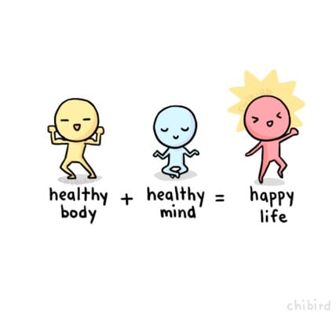
What is Wellbeing?
Physical Health
Healthy bodies and healthy minds
Mental Health

Slide 3
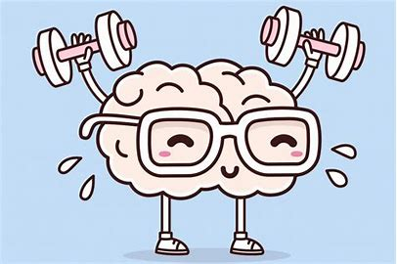

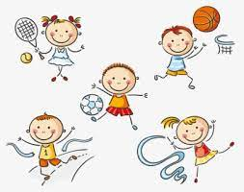

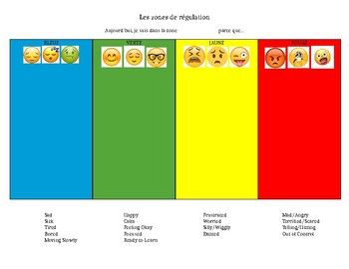
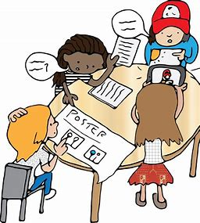


How children are encouraged to look after their Wellbeing at our school
Visit the nature garden.
Get active in
PE lessons and at playtime.
Get creative in art, music and computing lessons
Use
growth mindset.
Keep learning new things everyday.
Offer healthy dinners and packed lunches.
Encourage children to be good friends and be kind.
Learn to share feelings.

Slide 4

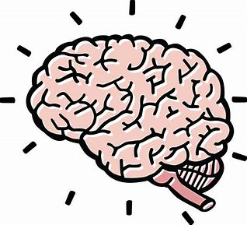
How do we encourage children to share their feelings at our school?
Zones of Regulation
There are four zones to describe how your brain and body feel.

Slide 5
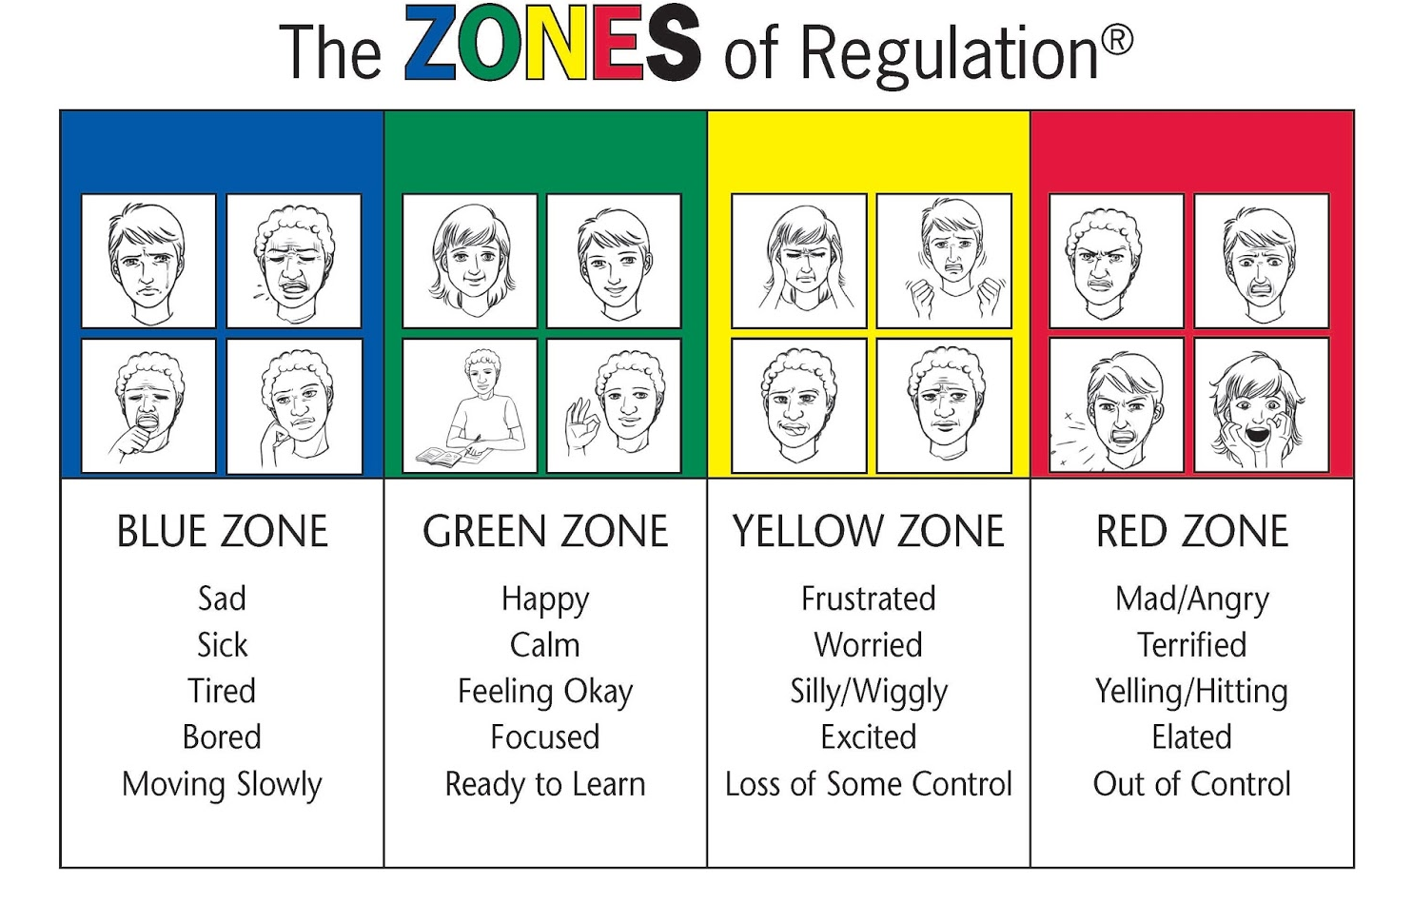
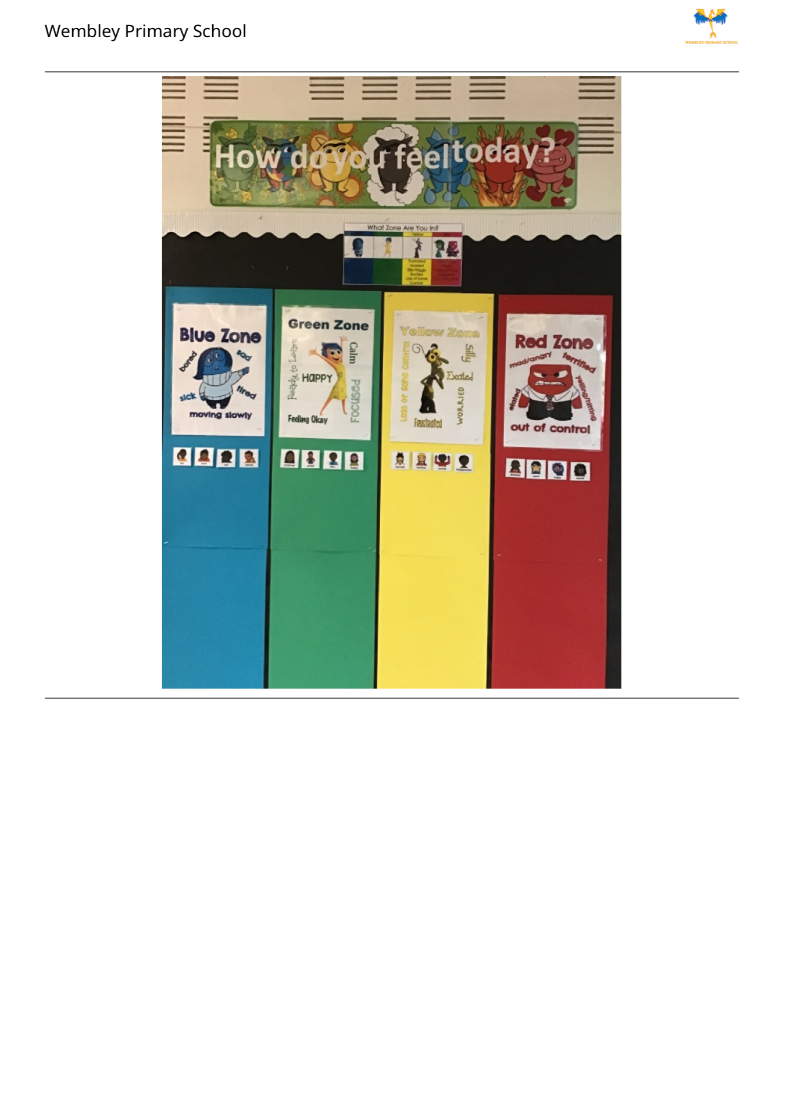
Zones of Regulation
Children are encouraged to share their feelings each day
Every class has a zones of regulation display

Slide 6
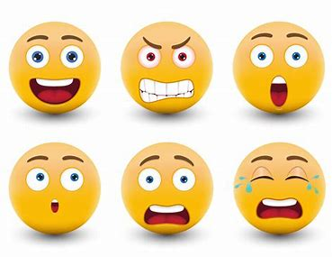
Well done for sharing your feelings with your teachers and classmates.
Remember – its okay to have any kinds of feelings.

Slide 7

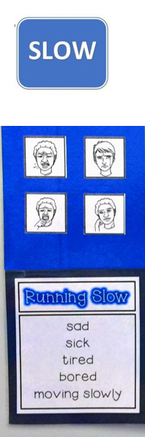
Your body is running slow, such as when you are tired, sick, sad or bored.

Slide 8

Like a green light, you are “good to go.” You body may feel happy, calm and focused and ready to learn.

Slide 9
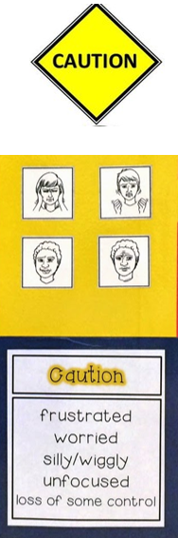
This zone describes when you start to loose control, such as when you are frustrated, anxious, worried, silly or surprised. Use caution when you are in this zone.

Slide 10
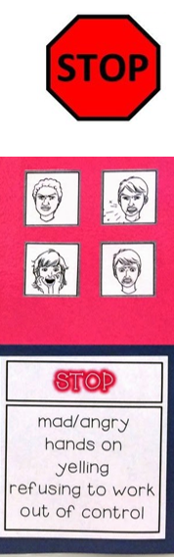
This zone is for extreme emotions such as anger, terror and aggression. When you are in this zone, you are out of control, have trouble making good decisions and must STOP!

Slide 11
Let me tell you about when I was in the ‘Caution Zone’
Teachers also share their feelings

Slide 12
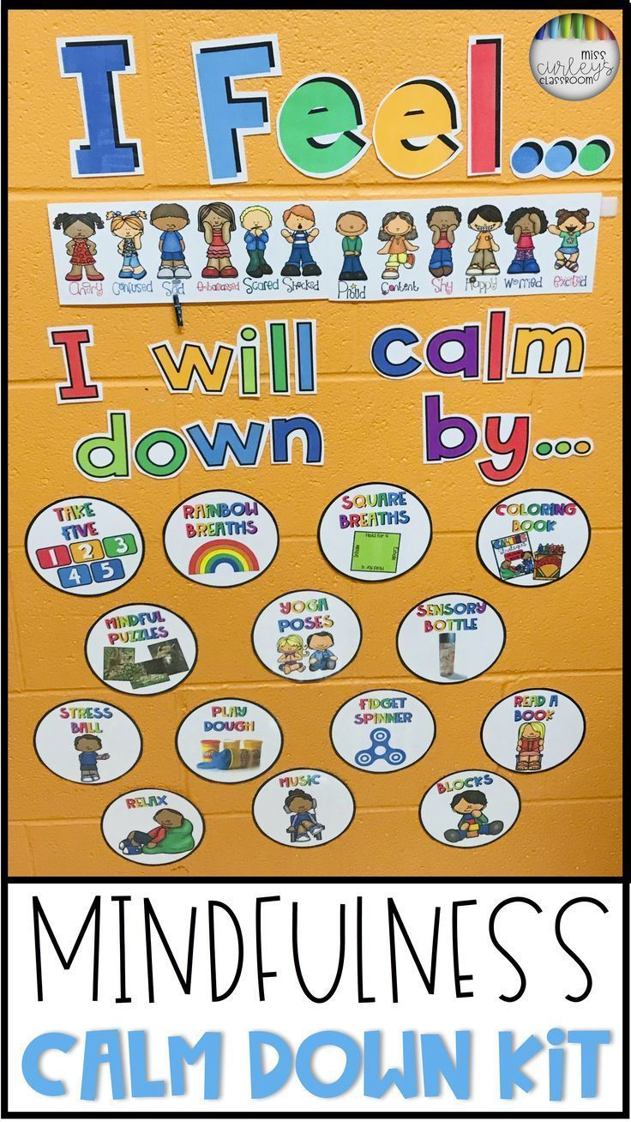
Take deep breaths
Listen to music
Read a book
Go outside
Play an instrument
Talk to my teacher/adult

Slide 13

Wembley Primary School
Website
Please take a look at the updated Wellbeing section for resources to help your child at home and additional support

Slide 14

Parent Champions
Attending meetings once a half term
Informing parents about Positive Wellbeing though class chat groups
Providing feedback of strategies used at school
How we can improve

