Slide 1


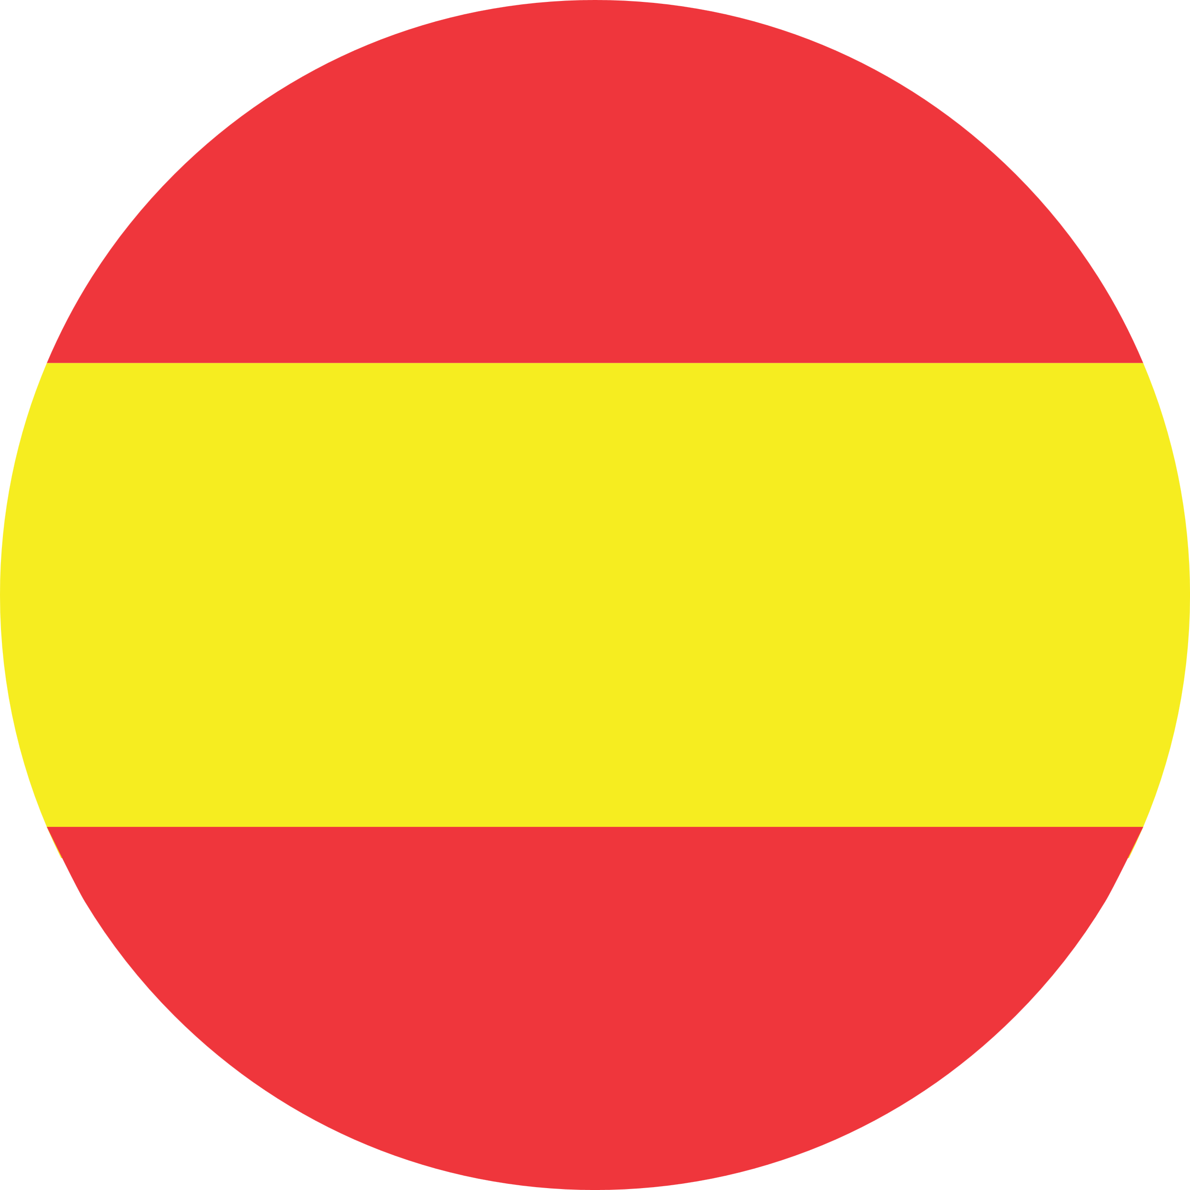

Year 3 Autumn 2 Knowledge Organiser:
The calendar & celebrations
Noun Bank
lunes - Monday
martes - Tuesday
miércoles - Wednesday
jueves - Thursday
viernes - Friday
sábado - Saturday
domingo - Sunday
Noun Bank
enero - January
febrero - February
marzo March
abril - April
mayo - May
junio - June
julio - July
agosto - August
septiembre – September
octubre – October
noviembre – November
diciembre - December
Question and Answer Bank
¿Cuándo es tu cumpleaños? - When is your birthday?
¿Qué día es hoy? - What day is it today?
Phonics
mier
ma
ju
bre
Grammar
When words are the same in two languages, we call them cognates and when they look very similar, we call them semi-cognates.
Fact
Months of the year and days of the week in Spanish do not have a capital letter.
Grammar
When you ask a question in Spanish you can turn a sentence into a question by raising the pitch of your voice at the end of the question. Practice reading these phrases!
Hoy es lunes. – Today is Monday.
¿Hoy es lunes? – Is it Monday today?
Fact
Some of the Spanish days of the week are named after the planets!
e.g. martes → Mars

