Slide 1
Monday 7th September 2020
L.O. – To revisit nouns and adjectives.

Slide 2
Recall what you know.
Whilst you have all been learning from home we have been aware that times have been tough.
We all want you to be hugely successful in literacy this year, as well as all the other subjects, therefore we are going to go back to the very beginning of your understanding so that we are sure we all start in the right way.

Slide 3
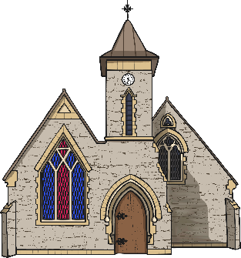
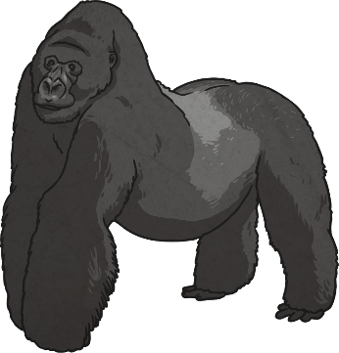
What is a Noun? a word used to identify any of a class of people, places, or things ( common noun), or to name a particular one of these ( proper noun ).
So we have Common Nouns and we have Proper Nouns.
What is the difference?
Common nouns are the general names for people, places, objects or animals. For example:

Slide 4
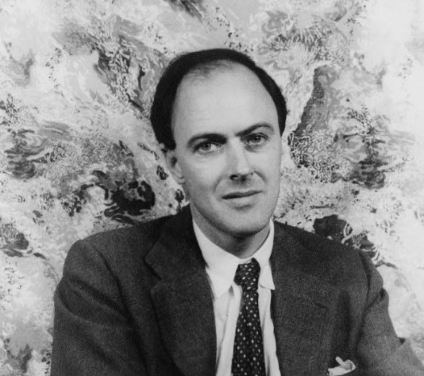
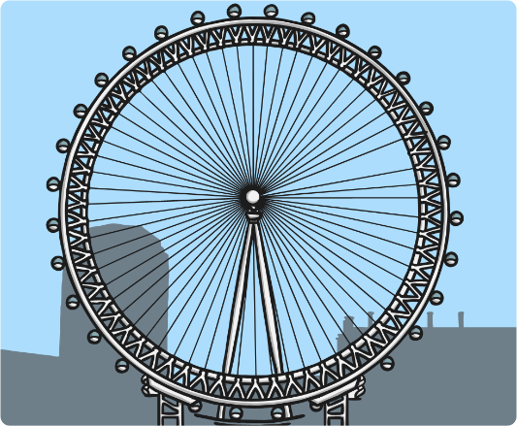
Proper Nouns
Proper nouns are different in that they name a specific place, object or person. They should also always start with a capital letter.
Sydney
Roald Dahl
London Eye
Months of the year, days of the week, some religious events and brand names are also considered to be proper nouns.

Slide 5
Find the Nouns
Look at the words below. Which ones are nouns?
Can you identify which of the nouns are Common and which are Proper?
candle
pretty
dancing
owl
bird
Joshua
flying
plane
car
tree
brown
crispy
tall
trousers
t-shirt
London
dog
jacket
Lego
shiny

Slide 6
What Is an Adjective?
An adjective is a describing word that can either:
come before a noun, e.g. The pupils did some remarkable work;
Stop
come after a form of the verb ‘to be’ (is/am/are/was/were/be/been/being),
e.g. The pupils’ work was remarkable.

Slide 7
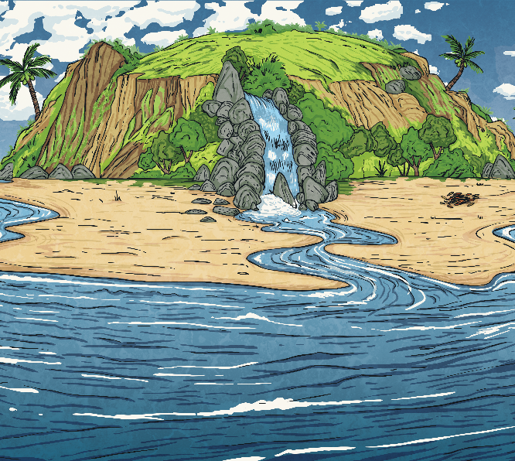
In year 6 we know you can use adjectives. We don’t just use adjectives we must improve and up-level the adjective.
Which more powerful words could replace the adjective to improve this sentence?
Thousands of miles away, a good island lay in the middle of the Mediterranean Sea.
You could have replaced ‘good’ with...
exquisite
splendid
marvellous
magnificent
glorious
breath-taking
superb
There are also many more!

Slide 8
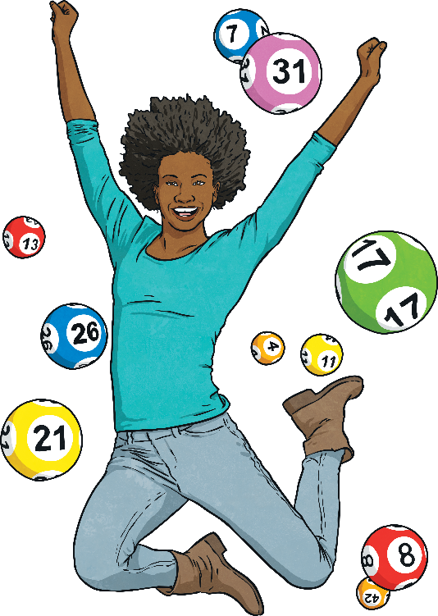
Improve the Adjective
Which more powerful words could replace the adjective to improve this sentence?
The happy lotto winner jumped for joy at her multi-million pound win.
You could have replaced ‘happy’ with...
ecstatic
jubilant
overjoyed
elated
euphoric
delighted
triumphant

Slide 9
Now that we have reminded ourselves with two of the Word Classes, we are going to put our knowledge into action.
We are going to look at a picture and will attempt to list all of the adjectives and the nouns we can about the picture.
Pens and pencils ready…

Slide 10
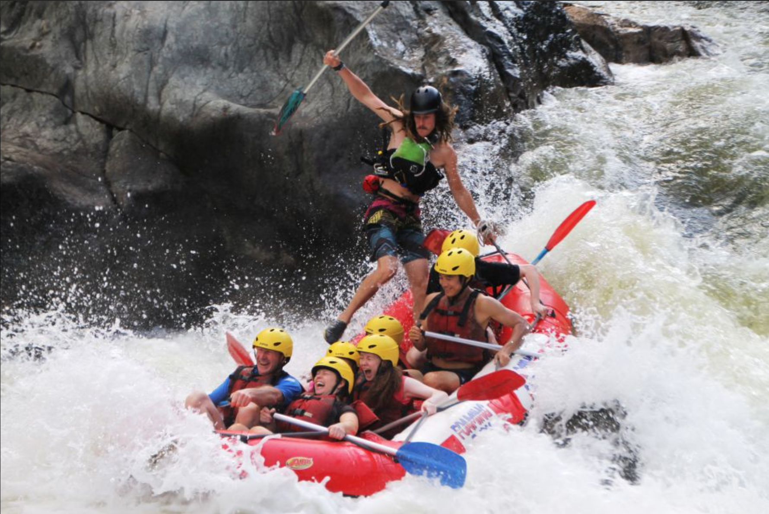

Slide 11
What did we come up with?
Nouns Adjectives

Slide 12
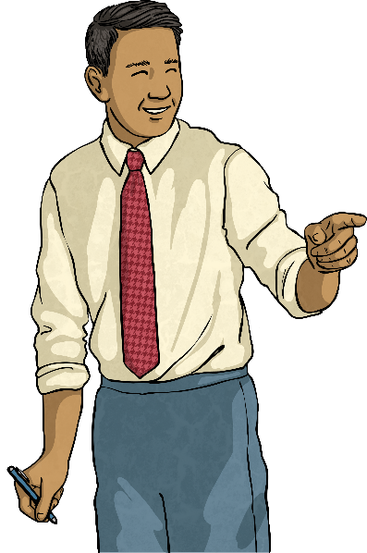
What Is an Expanded Noun Phrase?
An expanded noun phrase gives much more detail than a simple noun phrase, for example:
A teacher
Add a noun to modify
A maths teacher
Add adjectives to modify
A helpful, friendly maths teacher
Add a prepositional phrase to give extra details
A helpful, friendly maths teacher with a fluffy moustache

Slide 13
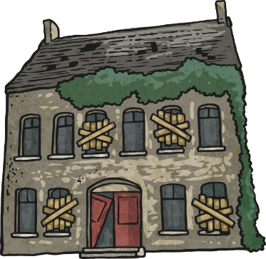
What Is an Expanded Noun Phrase?
An expanded noun phrase gives much more detail than a simple noun phrase, for example:
A house
Add a noun to modify
A country house
Add adjectives to modify
A derelict, old country house
Add a prepositional phrase to give extra details
A derelict, old country house with boarded and broken windows

Slide 14
We are going to look at the nouns and adjectives that we found earlier and see if we can create a few Expanded Noun Phrases. You’ll get to look at the photo again as a reminder and then we will see the results.

Slide 16
Reflection – Whose was the most impressive to you? Why? Are there any words you can steal and could reuse in your work?

Slide 17
Tuesday 8th September 2020
L.O. – To revisit verbs and adverbs.

Slide 18
What Is a Verb?
What is a verb? Recall your previous learning and see if you can define what a verb is.
A verb is a doing, being or action word.
Can you spot the verbs in these sentences?
The wolf walked into the woods.
The wolf walked into the woods.
He followed the path as he strolled towards the straw cottage.
He followed the path as he strolled towards the straw cottage.
When he reached the old, rickety door, he tapped it and waited.
When he reached the old, rickety door, he tapped it and waited.

Slide 19
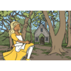
Boring Verbs
Some sentences contain verbs that are just a little boring!
They don’t give lots of information about the action or make the text very exciting.
One day, Goldilocks walked through the forest.
Edit this sentence and replace ‘walked’ with a different, powerful verb which shows the action clearly and gives clues about how or why the action is taking place.
One day, Goldilocks skipped through the forest.
One day, Goldilocks sauntered through the forest.
One day, Goldilocks meandered through the forest.

Slide 20
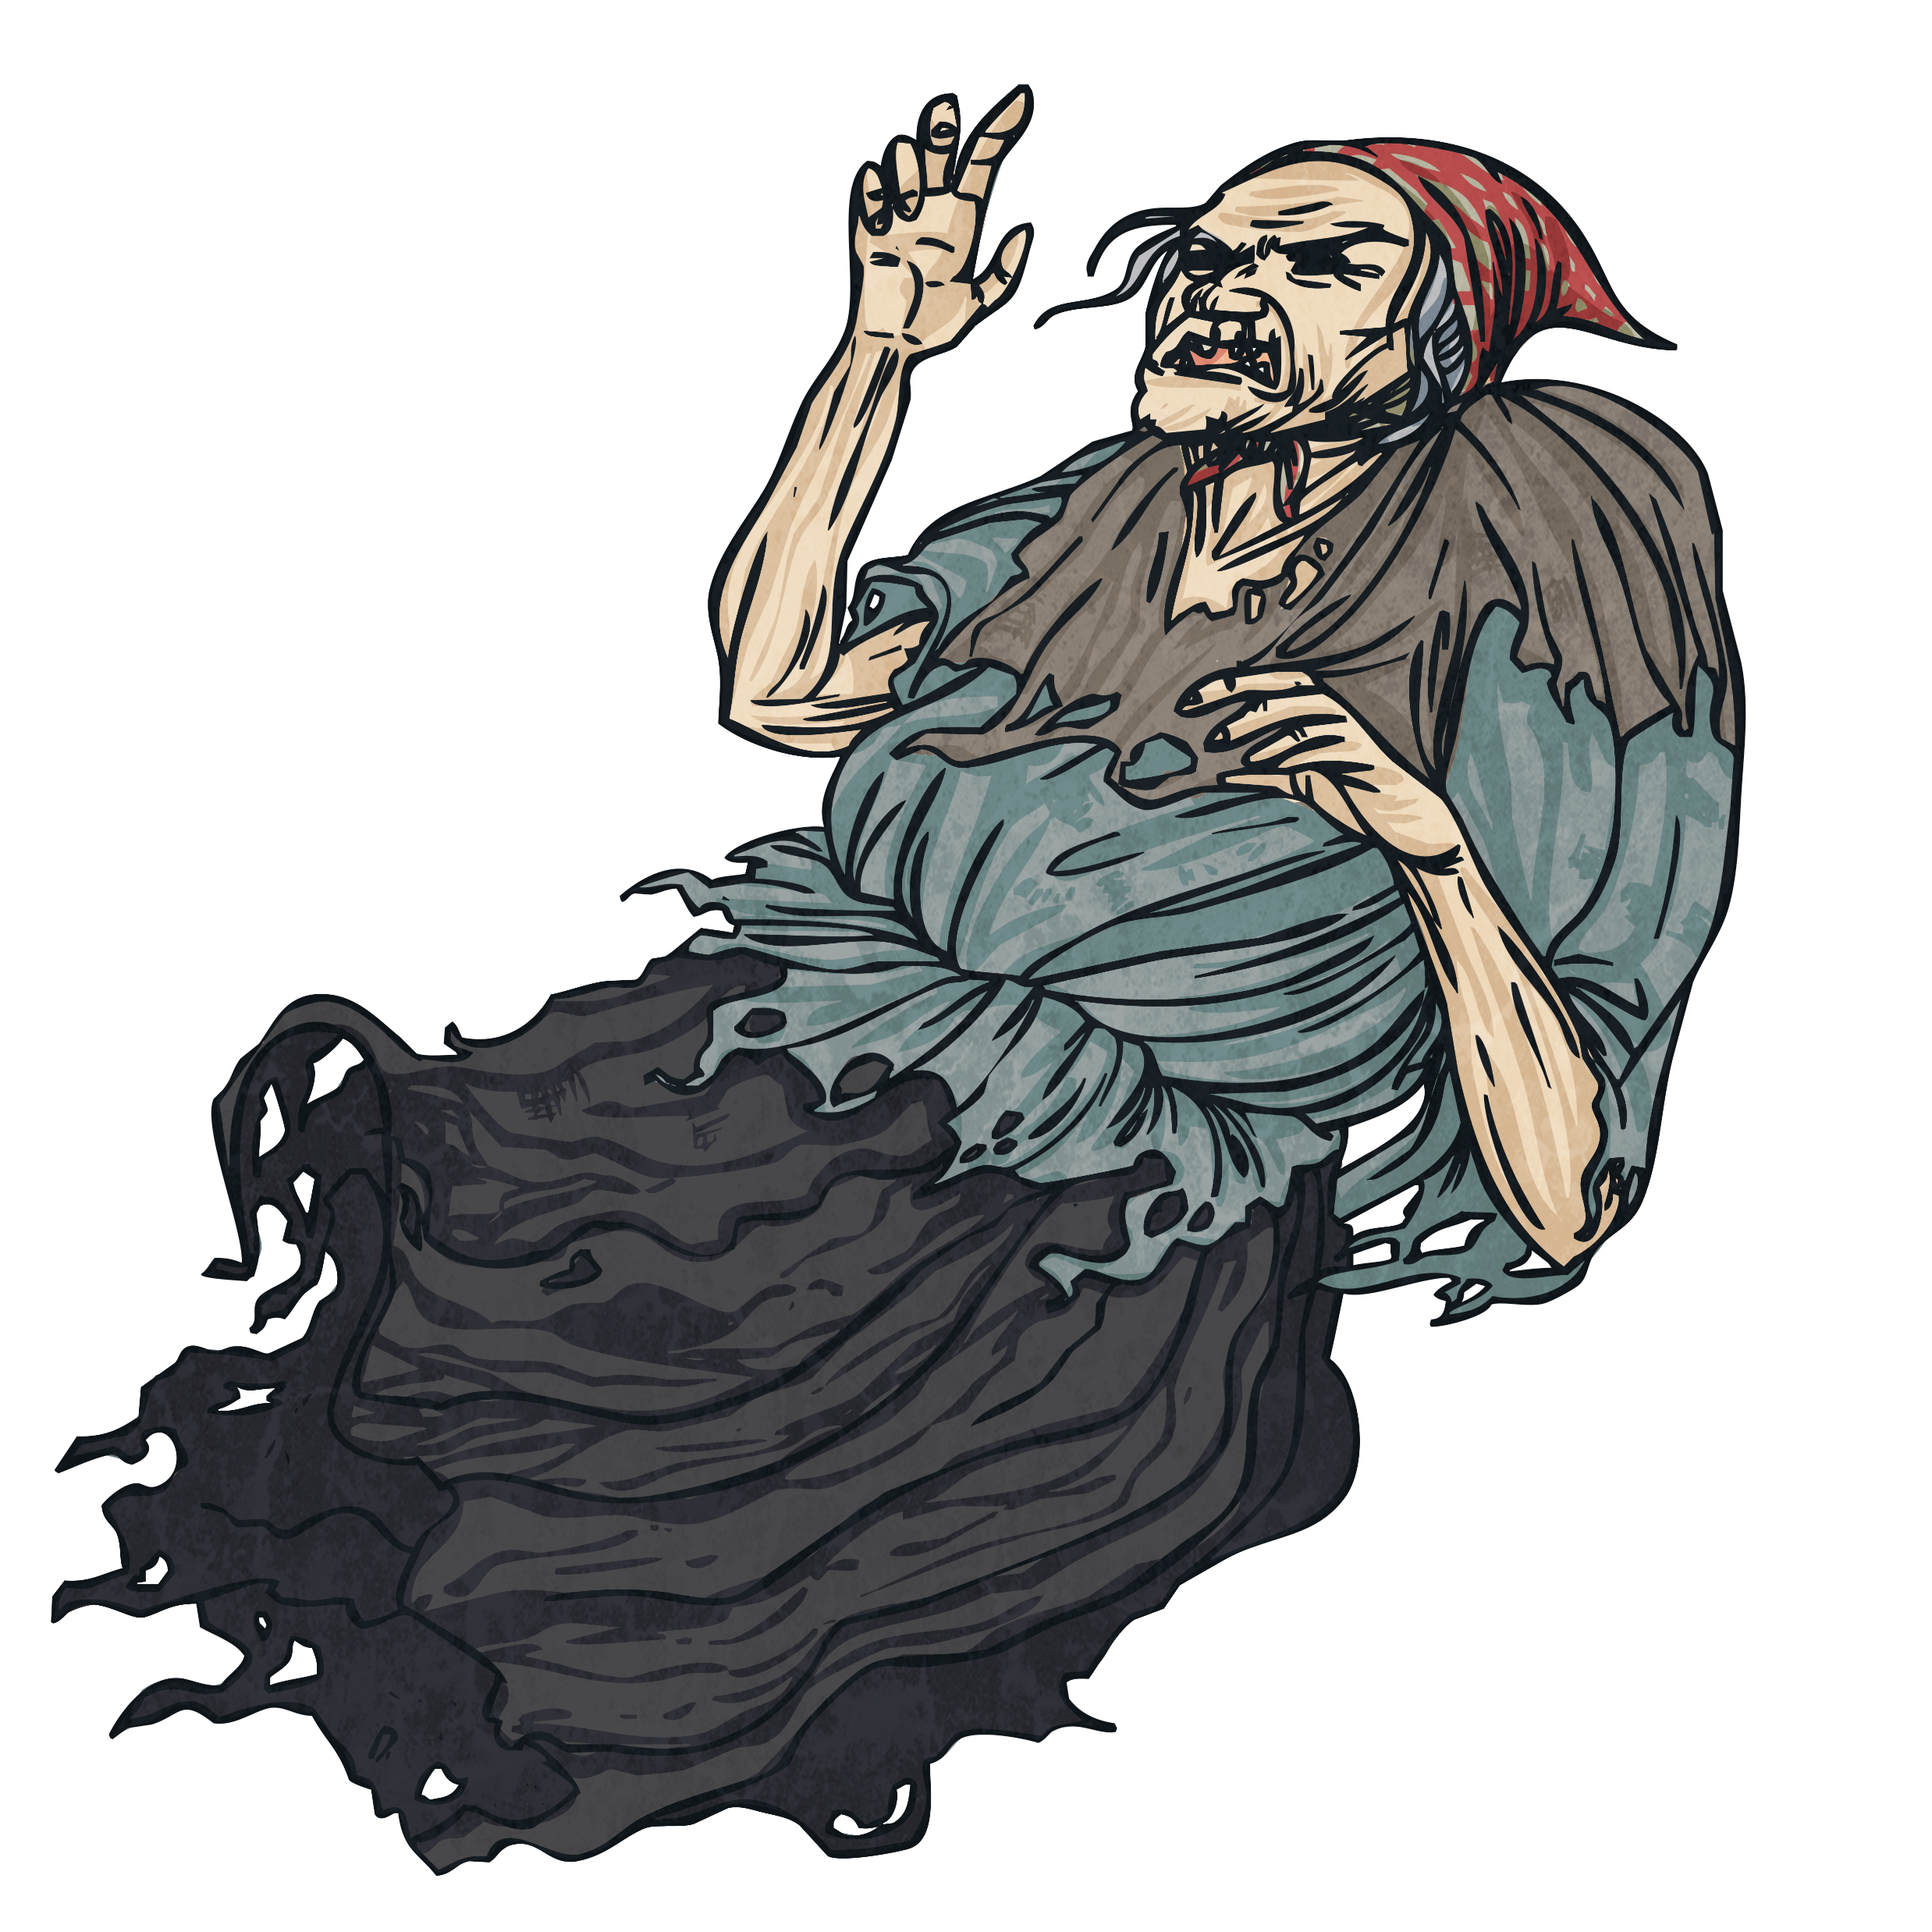
Improve the Verb
With your partner, use a whiteboard and replace the verb in this sentence with a strong and powerful verb to show the action.
The haggard witch fell towards the ground.
You could have replaced ‘fell’ with...
hurtled
plunged
descended
tumbled
plummeted
sunk
crashed
dropped
toppled

Slide 21
Improve the Passage
Can you spot all of the verbs in this passage and improve them? Choose a verb that will create a clear picture for the reader. Use the word bank below to help you if you need it.
The morning had finally arrived. Jack woke before sunrise and went to the window. There was a beanstalk. He quickly washed his face, put on his clothes and put on his shoes before running outside. He stood at the bottom of a colossal beanstalk, looking up with wonder.
The morning had finally arrived. Jack woke before sunrise and went to the window. There was a beanstalk. He quickly washed his face, put on his clothes and put on his shoes before running outside. He stood at the bottom of a colossal beanstalk, looking up with wonder.
Word Bank
roused
rose
scrubbed
prodded
stirred
threw
donned
pulled
forced
sprinted
scampered
gazed
marvelled
observed
splashed
freshened
dampened
cleansed

Slide 22
What Is an Adverb?
a word or phrase that modifies or qualifies an adjective, verb, or other adverb or a word group, expressing a relation of place, time, circumstance, manner, cause, degree, etc. (e.g., gently, quite, then, there ).
The most important thing to remember here is that an adverb modifies. It gives a clearer understanding to the reader about what you are attempting to illustrate in your writing.

Slide 23
What Is an Adverb?
Can you remember what an adverb does? Which of these are adverbs?
Sort them into the correct places in the table.
Adverbs | Not Adverbs
happily
lonely
very
rainy
busy
yesterday
always
totally
smelly
daytime
angrily
furious
sad
daily

Slide 24
Which Word Is Being Modified?
When using adverbs it is important to know which word you are modifying. This means you have full control over what you are writing.
In the following sentences an adverb has been circled, but which word is it modifying?
Sam eats his crisps noisily.
I am so excited about our school trip to the zoo.
She could possibly be the worst driver in the world.
Jacob walked incredibly slowly to the head’s office.
Kara has amazingly bright pink hair at the moment.
verb
adjective
verb
adverb
adjective
Extension:
Can you identify which part of speech the modified words were?

Slide 25
Using the photo we used yesterday, we are going to try and find suitable verbs and then find an adverb to match it. Pens and pencils ready…

Slide 27
What did we come up with?
Verbs Adverbs
** Try swapping your verbs and adverbs around and see if it still makes sense. You can use this technique to help make your writing a little more interesting.

Slide 28
Fronted Adverbials
What is an adverbial?
An adverbial is a word, phrase or clause that is used, like an adverb, to modify a verb or a clause. Adverbs can be used as adverbials, but many other types of words, phrases and clauses can be used in this way, including prepositional phrases and subordinate clauses.
What is a fronted adverbial?
When an adverbial is used at the beginning of a sentence, they are often called ‘fronted adverbials’.

Slide 29
Types of Fronted Adverbial
Fronted adverbials are used to describe…
the time something happens,
e.g. Before sunrise, Darius crept into the beast’s cave.
the frequency (how often) something happens,
e.g. Every so often, Darius could hear the beast’s ferocious snore.
the place something happens,
e.g. At the back of the cave, the terrifying creature began to stir.
the manner something happens,
e.g. As quick as a flash, Darius bounded behind a nearby rock.
the possibility (how likely) something will/has happen(ed),
e.g. Almost certainly, the deadly beast would find Darius.
Did you notice how the fronted adverbials were punctuated?

Slide 30
Adding Commas
Every fronted adverbial word, phrase or clause needs to be followed by a comma to separate it from the main clause of the sentence. Where should the comma go in this fronted adverbial sentence?
Slowly and carefully they released the juvenile badger back into the wild.
,
Does the fronted adverbial describe the time, frequency, manner, place or possibility of the action in the main clause?

Slide 31
Adding Commas
Where should the comma go in this fronted adverbial sentence?
On Tuesday Class 12 are visiting The Imperial War Museum.
,
Does the fronted adverbial describe the time, frequency, manner, place or possibility of the action in the main clause?

Slide 32
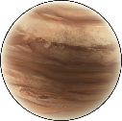
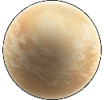
Writing Your Own Fronted Adverbials: ISPACE
Using ISPACE can help you remember six different ways to create fronted adverbials...
I
-Ing word
e.g. Shaking with fear, ...
S
Simile
e.g. Like a raging bull, ...
P
Preposition
e.g. Behind the clouds, ...
A
Adverb
e.g. Anxiously, ...
C
Conjunction
e.g. After he opened his eyes, ...
E
-Ed word
e.g. Exhausted, ...

Slide 33
Building Fronted Adverbials into what we’ve learnt today.
_________ __________ , _________ _______ ________.
ISPACE pronoun verb adverb.
Can you complete your own fronted adverbials about the picture we have been using?

Slide 34
Reflection – Complete the table
Type of Word | Example
Verb
 | He, she, they
Proper Noun
 | Leisurely, casually, apprehensively,

Slide 35
Wednesday 9th September 2020
L.O. – To revisit conjunctions.

Slide 36
Let’s Get Started
What is a conjunction?
A conjunction links two or more words, phrases or clauses together.
There are two main types of conjunctions we use within sentences.
Do you know what they both are?
co-ordinating conjunctions (e.g. and) link two main clauses together as an equal pair to create a compound sentence. We usually remember these words using the acronym ‘FANBOYS’.
subordinating conjunctions (e.g. when) introduce a subordinate clause. You can remember some of the most useful subordinating conjunctions by ‘I SAW A WUBUB’.

Slide 37
Main Clauses
What is a main clause?
A main clause (or it could be called a simple sentence) is a group of words that expresses one complete thought. Every main clause must contain a subject and a verb. They can also be called independent clauses.
Can you spot the subjects and the verbs in these main/independent clauses?
subject
The horse galloped.
The horse galloped.
The horse galloped.
verb
Mr Richardson ate some cheese.
Mr Richardson ate some cheese.
Mr Richardson ate some cheese.

Slide 38
Both of these main/independent clauses make sense on their own.
Samira likes football.
Ben loves basketball.
and
When we link them together with a co-ordinating conjunction, they form a compound sentence.

Slide 39
There are seven co-ordinating conjunctions that we can remember using the mnemonic ‘FANBOYS’.
for
and
nor
but
or
yet
so
Samira likes football.
?
Ben loves basketball.
Which other co-ordinating conjunctions could be used to link these two main/independent clauses?

Slide 40
for
and
nor
but
or
yet
so
It was time for maths.
?
My pencil broke.
Which co-ordinating conjunctions could be used to link these two main/independent clauses to create a compound sentence?
Is there one that fits best?
Are some co-ordinating conjunctions easier to use than others?

Slide 41
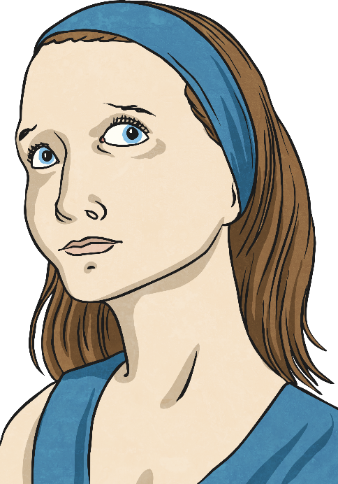
Practise Your Skills
How could you add a co-ordinating conjunction and another main/independent clause to create a compound sentence?
There was a mysterious sound.
for
and
nor
but
or
yet
so
?

Slide 42
Facing Forward.
TASK
See if you and your partner can give three good examples of compound sentences using FANBOYS.

Slide 43
Complex Sentences
What is a complex sentence?
A complex sentence is made up of a main clause and then one or more dependent clauses.
There are two ways of creating dependent clauses:
by using a subordinating conjunction (e.g. after) to create a subordinate clause, e.g.
The horse galloped after it jumped the fence.
by adding extra information using a relative clause.
Mr Richardson, who was feeling ravenous, ate some cheese.

Slide 44
Subordinating Conjunctions
Firstly, let’s look at creating complex sentences by using subordinate clauses that begin with a subordinating conjunction.
I
S
A
W
A
W
A
B
U
B
is an acronym to help you remember the first letters of some of the most important subordinating conjunctions.
If
Since
As
When
Although
While
After
Before
Until
Because

Slide 45
Subordinating Conjunctions
So, how do we use subordinating conjunctions?
Subordinating conjunctions are the first words within a subordinate clause. Subordinate clauses do not make sense on their own but when they are used with a main clause, they create a complex (multi-clause) sentence.
Subordinate clauses will always have a subject and verb within them, e.g.
before they left
verb
subordinating conjunction
subject

Slide 46
Can you spot the subordinate clause and the subordinating conjunction in this complex sentence?
Juvenile penguins are able to swim, although their feathers aren’t yet waterproof.
Juvenile penguins are able to swim, although their feathers aren’t yet waterproof.

Slide 47
In the complex sentence we looked at, the subordinate clause has always come after the main clause but watch…
Juvenile penguins are able to swim although their feathers aren’t yet waterproof.
Although their feathers aren’t yet waterproof, juvenile penguins are able to swim.

Slide 48
Although their feathers aren’t yet waterproof, juvenile penguins are able to swim.
Subordinating conjunctions can also be used as the first word in a complex sentence. When the subordinate clause comes before the main clause, make sure you remember to use a comma to mark where the subordinate clause ends.

Slide 49
Complete in books.
Can you swap these sentences around so that the subordinate clause comes before the main clause? Don’t forget your commas!
The boy scouts sang around the campfire until it was time for bed.
Until it was time for bed, the boy scouts sang around the campfire.
Hakim could win the talent contest if he improved his juggling skills.
If he improved his juggling skills, Hakim could win the talent contest.

Slide 50
Practise
Now, it’s your turn. Could you add a subordinate clause (using an I SAW A WABUB! subordinating conjunction) to this main clause to create a complex sentence:
my little sister is so irritating
Did you place your subordinate clause before or after the main clause? Did you include the correct punctuation?

Slide 51
Complete in your books. Independent Task
See if you can –
1) Write a simple sentence.
2) Explain why it is a simple sentence.
3) Write a compound sentence using a conjunction.
4) Explain why it is a compound sentence.
5) Write a complex sentence using a conjunction.
6) Explain why it is a complex sentence.
7) Explain in your own words why we use simple, compound and complex sentences.

Slide 52
Review
Which of these examples are complex sentences? Can you explain why?
Giraffes have very long necks, which they use to their advantage to reach tall trees.
Giraffes have very long necks, which they use to their advantage to reach tall trees.
The alien approached the spaceship so the crew gasped.
Before lunch, Cassie cycled into town.
Before his Grandma arrived, Billy frantically tidied his bedroom.
Before his Grandma arrived, Billy frantically tidied his bedroom.

Slide 53
Review
Complete the sentences below by adding your own subordinate clause using your choice of subordinating conjunctions. Your dependent clause can become before or after the main clause.
he had broken the world record
science is an interesting subject

Slide 54
Thursday 10th September 2020
L.O. – To examine paragraph writing.

Slide 55
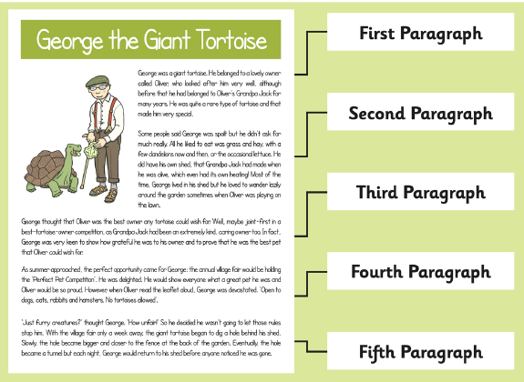
What is a Paragraph?
A paragraph is a group of sentences within a piece of writing which is written about the same idea or topic.

Slide 56
Creating Cohesion
When the ideas within paragraphs link well together we say the paragraph has cohesion.
You can think of cohesion like glue holding the text together.
What do you think cohesion does?
It keeps order in the paragraph.
Related ideas are kept together.
It makes it easier for the reader to understand the text.
Ideas flow more smoothly.
It provides links between ideas.

Slide 57
Creating Cohesion
You can connect ideas in separate sentences by using connecting adverbs.
Connecting adverbs (and adverbial phrases and clauses) maintain the cohesion of a text in several ways:
emphasis/addition – furthermore, moreover, also
opposition – however, nevertheless, on the other hand, instead, in contrast, looking at it another way.
reinforcing – besides, anyway, after all
explaining – for example, in other words, that is to say
listing - first of all, finally
indicating result – therefore, consequently, as a result
indicating time – just then, meanwhile, later, after

Slide 58
Creating Cohesion
Connecting adverbs/adverbials can also help to create cohesion within paragraphs.
They join separate sentences together and ensure that ideas flow more smoothly.

Slide 59
Creating Cohesion
Commas are often used to mark off connecting adverbs/adverbials. Can you spot the connecting adverbs / adverbials in these sentences?
First of all, I want to welcome you to the meeting.
I didn’t think much of the film. Helen, on the other hand, enjoyed it.
I was upset. However, I didn’t say anything.

Slide 60
Creating Cohesion
Answers
First of all, I want to welcome you to the meeting.
I didn’t think much of the film. Helen, on the other hand, enjoyed it.
I was upset. However, I didn’t say anything.

Slide 61
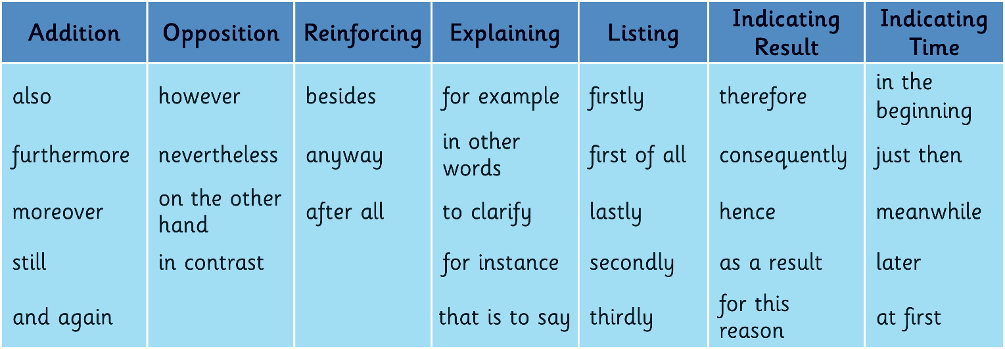
Connecting adverbs can be grouped according to their function. This may help you understand them a bit better:
Can you create two sentences which are linked together using one of the connecting adverbs?

Slide 62
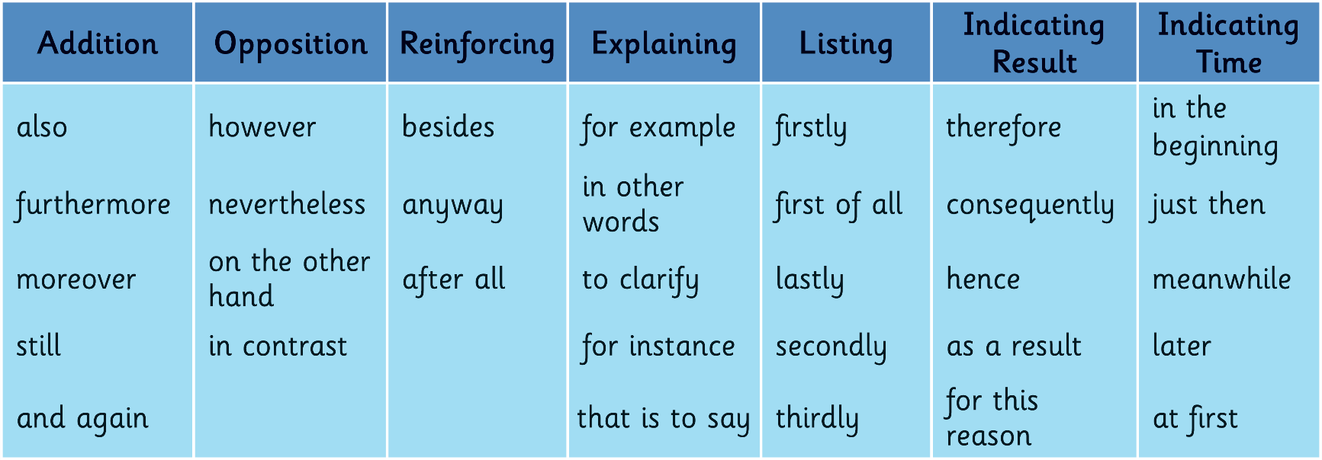
Match it
Different types of text may use particular types of connecting adverbs, but some connecting adverbs can be used in more than one type of text.
Talk to a partner. Match the heading to the type of text the connecting adverbs would work well with.
Diaries
Recounts
Persuasion
Stories
Non-chronological Reports
Explanations
Instructions and Procedures
Discussions or balanced arguments

Slide 63
TASK
Remember this photo?
Today you are going to attempt to write two paragraphs.
That is it, simple, right?

Slide 64
We need to include all of the information that we have been reminded of this week.
Without looking through our books can you tell me what have we rediscovered?

Slide 65
TASK
Write 2 paragraphs using –
Nouns & Adjectives
Verbs & Adverbs
Different sentence lengths
Conjunctions
Cohesive paragraph linking
Which text type should we use to make this easier for us all?

Slide 66
Live Write
Look at how I write and what techniques I use to make sure my sentences make sense.
Am I right every time or do I correct myself regularly?
Am I not a good writer because I keep changing my ideas and sentence lengths?
Now it’s your turn.
Be aware that you have not written in a long time so take your time and have a go.

Slide 67
Review
Discuss with your partner.
(Remember to face forward)
What did you find really easy to do?
What part are you most proud of?
Which section was the hardest to write?
What do you need to practice again to get better at?

Slide 68
Friday 11th September 2020
L.O. – To conference and self-evaluate your work.

Slide 69
Your task yesterday was to -
TASK
Write 2 paragraphs using –
Nouns & Adjectives
Verbs & Adverbs
Different sentence lengths
Conjunctions
Cohesive paragraph linking
How did you get on?
Was it easier or harder than you thought?
Why?

Slide 70
Proof Reading & Editing
Proof Reading
Proof reading is reading through your work to see if it makes sense. Occasionally people miss out words which then means that your work does not make sense. Punctuation is also an area to focus on when proof reading. It is a way of clearing and tidying up your work. You need to use your green pen to make adjustments when proof reading.
Editing
Editing is when a larger section of work needs to be rewritten. It may be the case that you took your narrative in the wrong direction or that a particular paragraph is too repetitive. This work may also be written in green pen, but away from the original piece you wrote and usually on a different page.

Slide 71
Have a look through the work you wrote yesterday and see if your work needs any proof reading adjustments or editing.
Try and improve your work.
In year 6 we always attempt to improve our work. It is a way of illustrating that we are constantly thinking and trying to better ourselves. The green pen helps show this, which is a wonderful thing.

