Slide 1
Wednesday 29th April 2020 L.O. To write captions for a picture. Watch the video story of the “Dream Giver”. The link to the video is in your (Skills) timetable. Draw a picture of him. When your picture is complete, add key words to write simple sentences to describe how the Dream Giver looks.

Slide 2
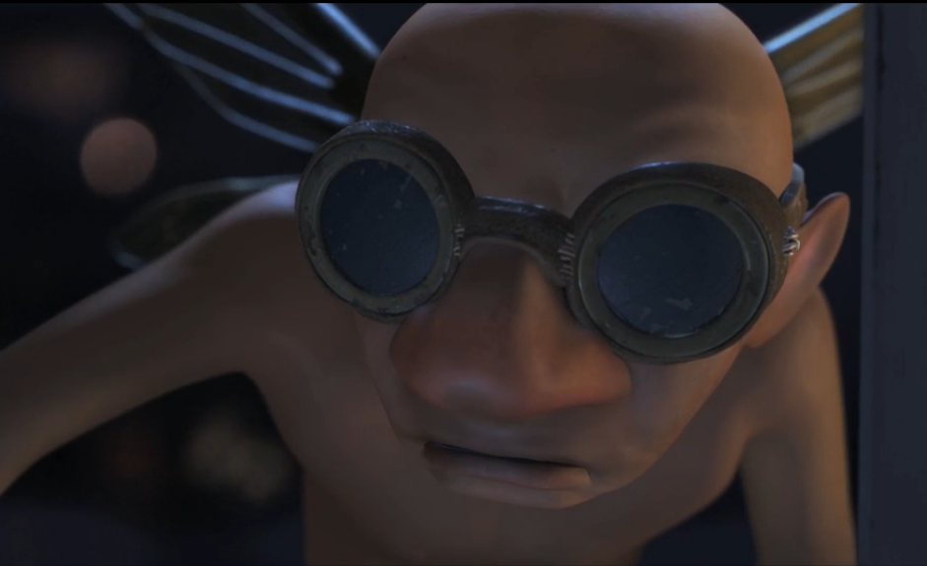
Old
Glasses
Skinny
Scary
Then challenge yourself by writing sentences using the adjectives you have come up with.
Examples:
The Dream Giver looks old.
He is a skinny man.

Slide 3
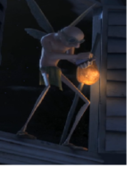
Thursday 30th April 2020 L.O: To write simple sentences.
Today you will writing captions about what the of The Dream Giver looks like using full sentences. When looking at the pictures, focus only on his appearance (what he looks like).
Remember your capital letters and full stops.
Capital letters are used at the beginning of a sentence and also for names of people and places.
Full stops go at the end of the sentence.
Also don’t forget to use finger spaces between words!
Example: The Dream Giver has long legs.

Slide 4
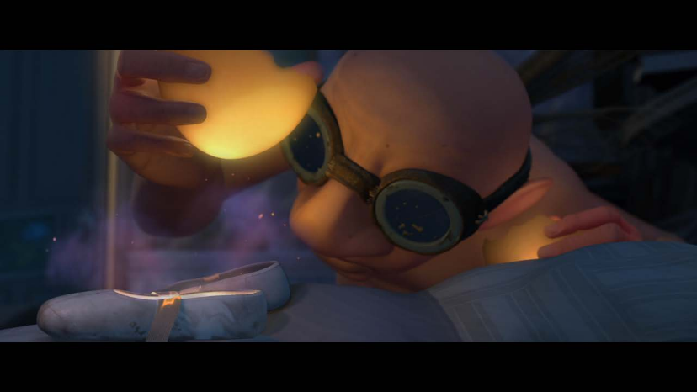
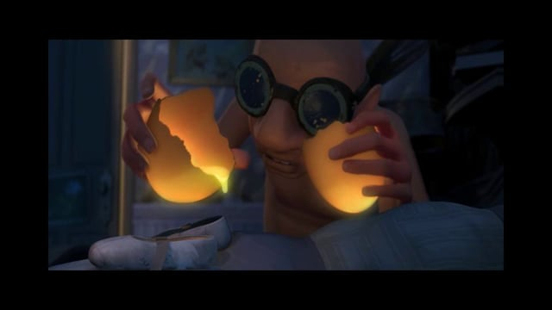
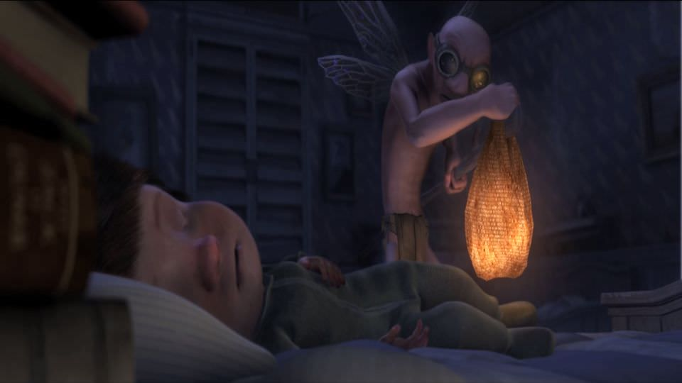
Write a sentence to describe:
his head,
nose,
glasses,
wings
and weight.

Slide 5
Friday May 1st 2020 L.O: To write a character description. Today you will be writing sentences to form a character description about The Dream Giver. You will only be focusing on his appearance. Remember appearance is what the character looks like. Make sure to include adjectives to describe his face, clothes, weight.
Old | Pointy wings | Nose
Head | Bald | Skinny
Weak | Tiny | Bag
Key words you could include

Slide 6
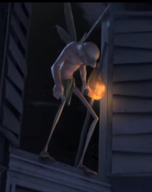
Using the key words you wrote around your drawing of the Dream Giver, write sentences about him.
Remember your capital letters and full stops. Capital letters are used at the beginning of a sentence and also for names. Full stops go at the end of the sentence. Also remember your finger spaces between words!
Here is an example to help you get started.
There is a man called The Dream Giver. The Dream Giver wears black glasses. He has pointy wings.
Try to challenge yourself by adding conjunctions such as and, or, but.
For example: The Dream Giver has black glasses and pointy wings.

