Slide 1
Plants
Lesson 2
Why do plants need leaves?

Slide 2
L.O: To understand the function of a leaf.
Success criteria:
I can make observations about leaves.
I can describe similarities and differences in leaves.
I can describe the function of a leaf.

Slide 3
Key vocabulary

Slide 7
What is a leave?
An alien has come to earth and has never ever seen a leaf…..How would you describe a leaf?

Slide 8
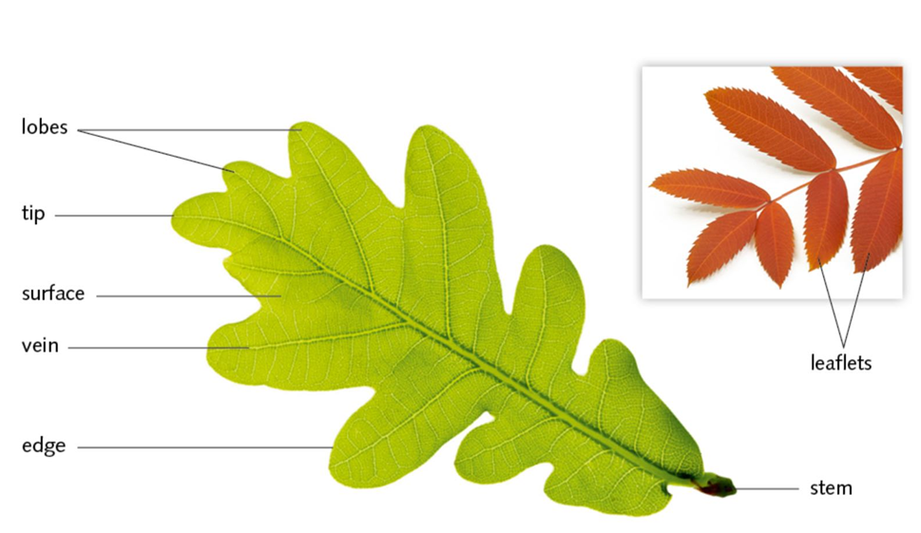
Different parts of a leaf

Slide 9
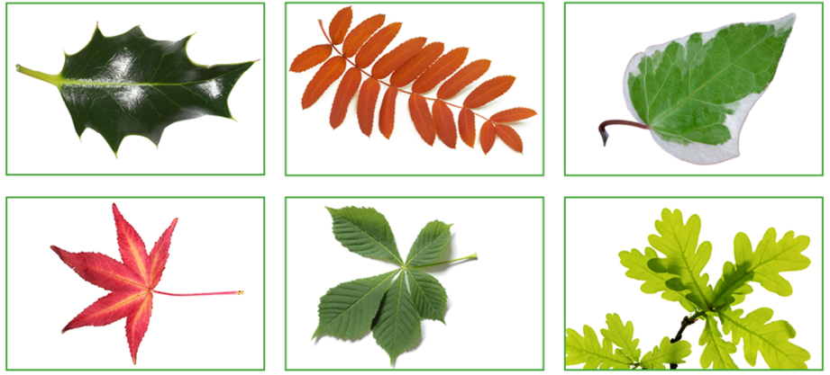
What’s the same? What’s different?

Slide 10
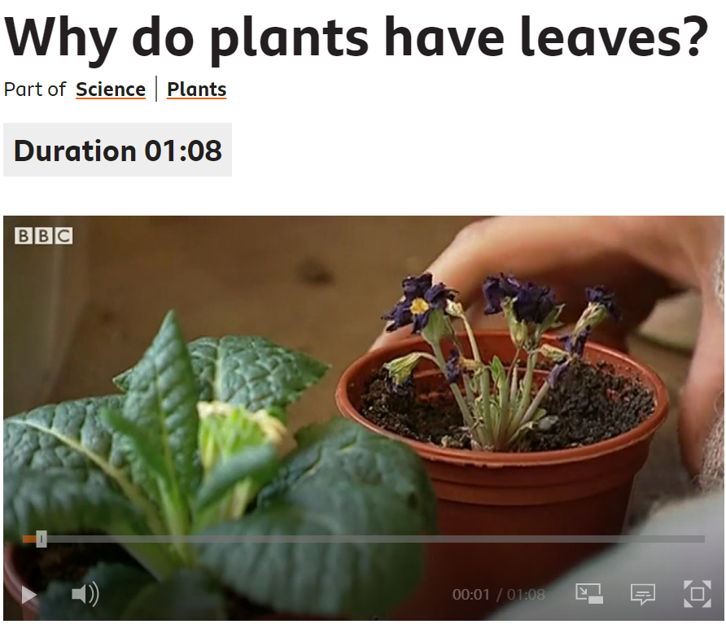
https://www.bbc.co.uk/bitesize/clips/z2k4d2p

Slide 11
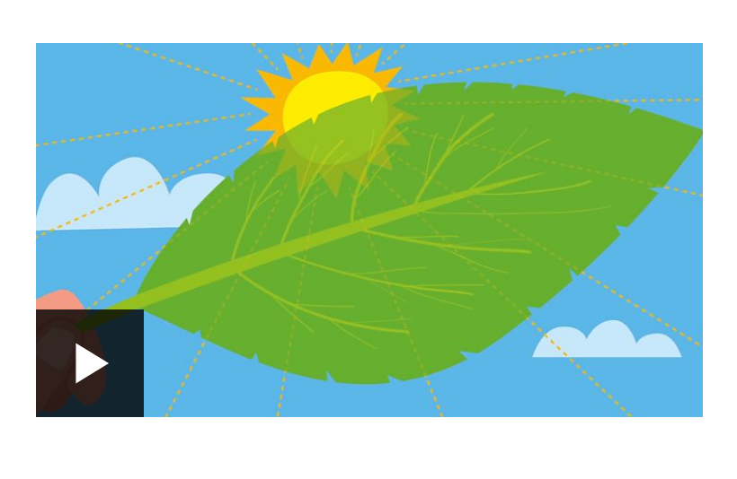
What is the role of leaves?
https://www.bbc.co.uk/bitesize/topics/zy66fg8/articles/z9gcdxs

Slide 12
Why do plants need leaves?
The leaves of a plant make food.
The leaves use sunlight to make food for the plant to use.
This is called photosynthesis.
Plants also breath through these leaves.
They take in carbon dioxide and give out oxygen.
We breath in this oxygen, that is why we need to grow lots of plants.

Slide 13
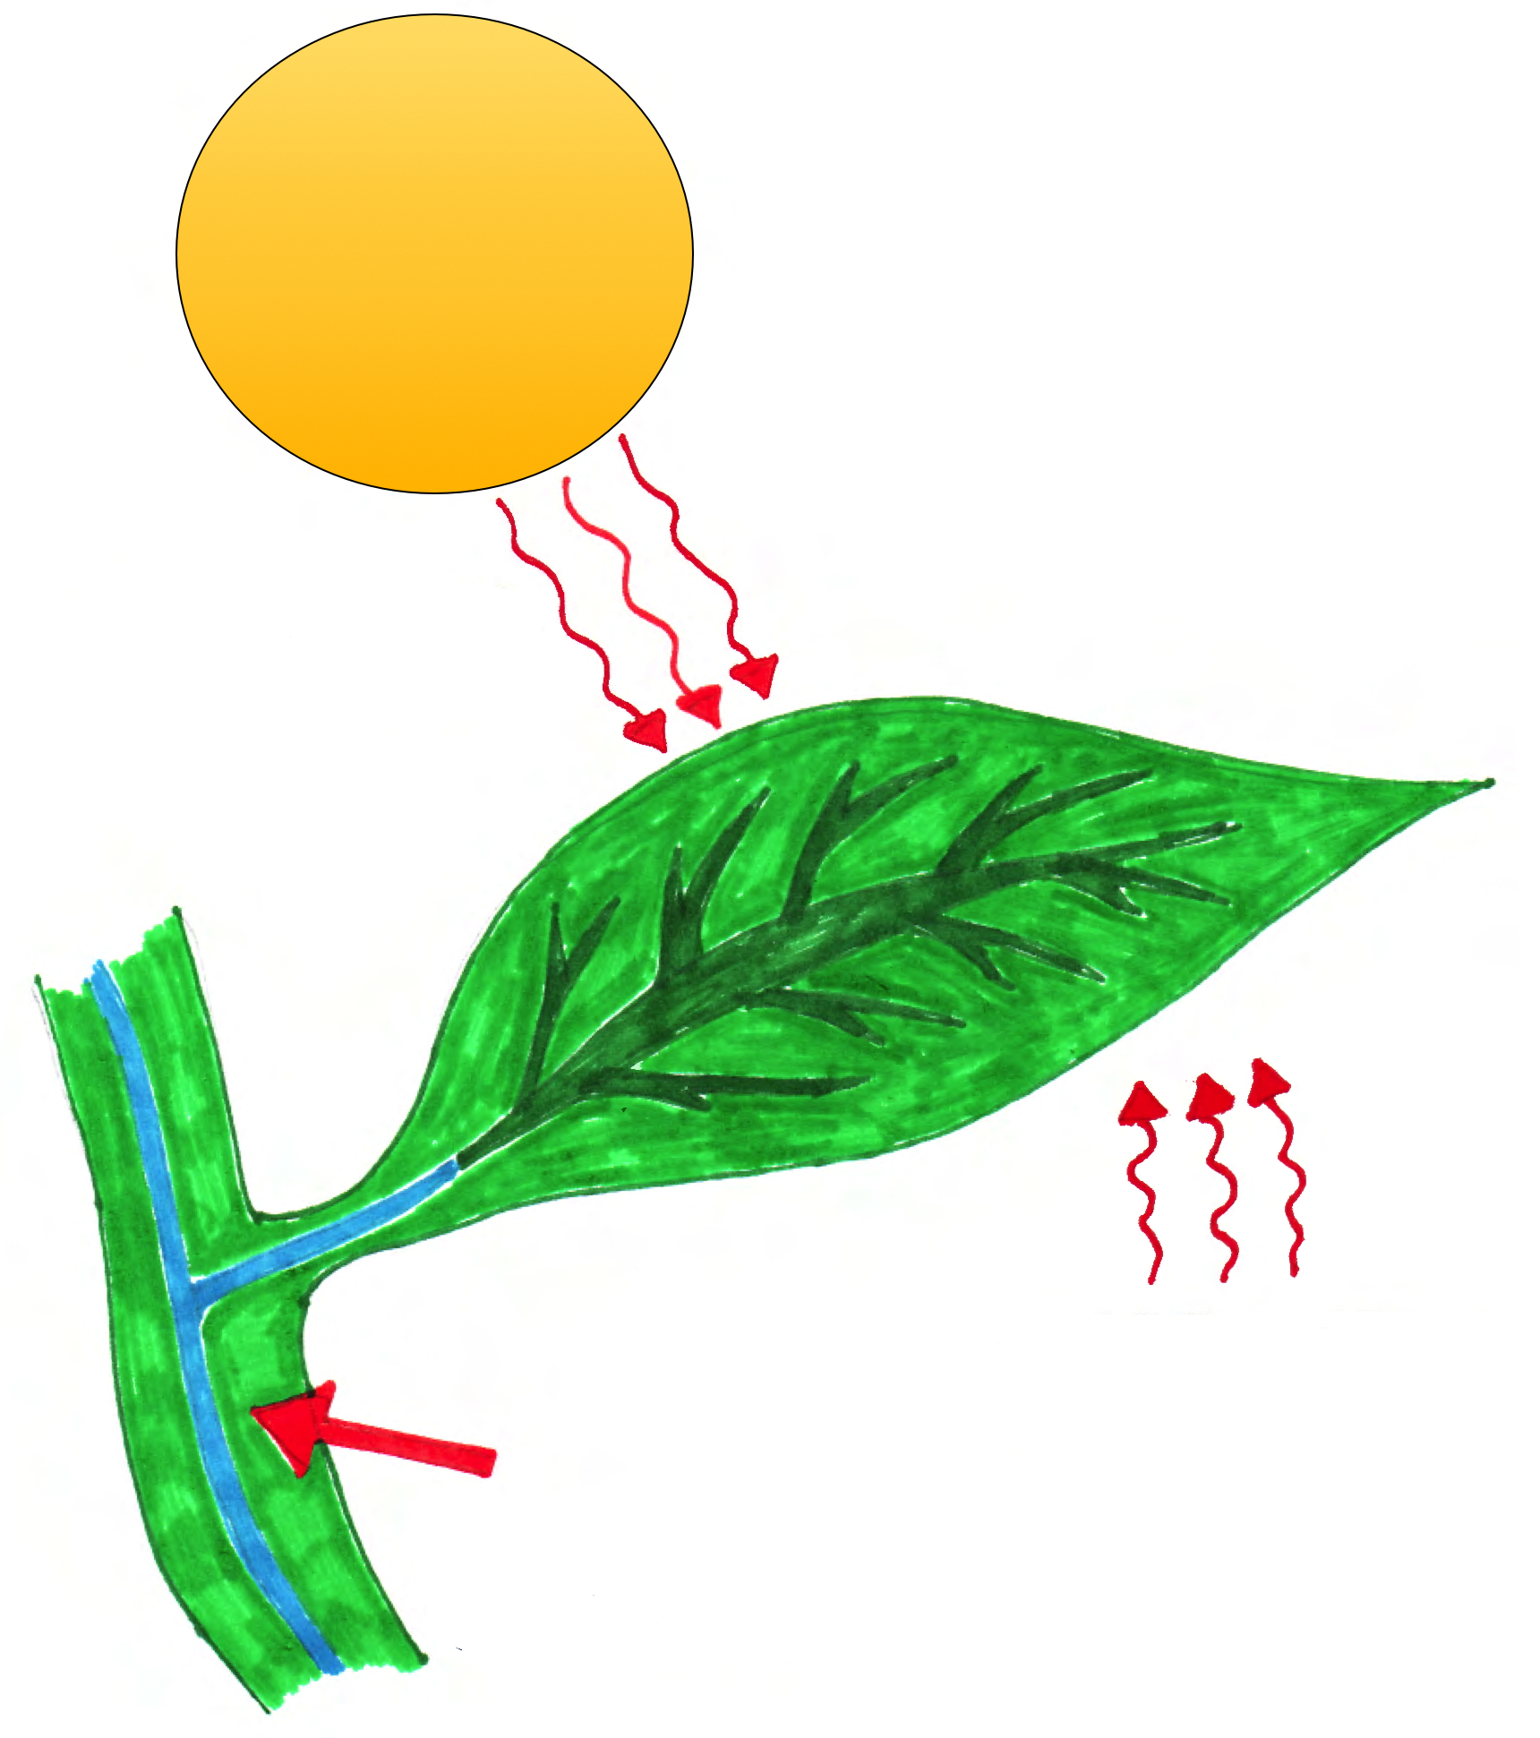
What do leaves need to photosynthesise?
Sunlight is absorbed by
the leaves
Carbon dioxide from the air passes through tiny holes in the leaves
The stem carries water
to the leaves

Slide 14
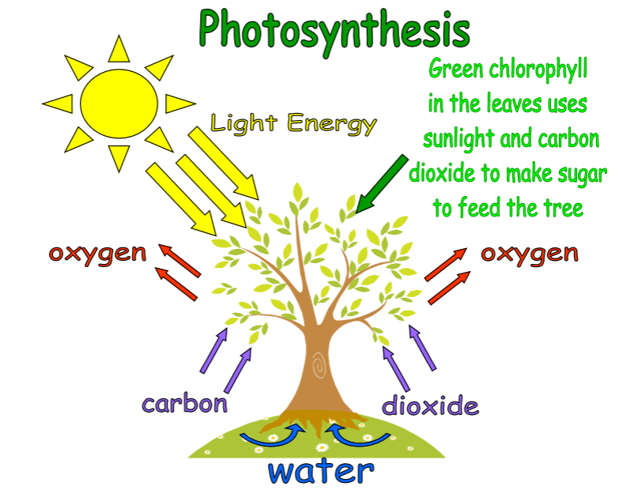

Slide 15
To make food plants need sunlight, water and a gas called carbon dioxide which they get from the air.
This process is called photosynthesis.
Leaves are usually green because they contain a chemical pigment (or dye) called chlorophyll.
Chlorophyll can absorb (soak up) sunlight.
Leaves also take in the gas carbon dioxide from the air around them through tiny holes in the leaves.

Slide 16
Task
Activity 1:
Draw a leaf and label the main parts.
Activity 2:
Draw and label a leaf. Describe what a leaf does.
Activity 3:
Create a poster that describes in detail the functions of a leaf. Don’t forget to include a labelled diagram as well as key vocabulary.

