Slide 2
Lesson 1:
L.O. to be aware that we are all part of different communities.

Slide 3
Local
Global
COMMUNITIES
National
Faith

Slide 4
What is a community?
1) A group of people living in the same place or having a particular characteristic in common.
2) The condition of sharing or having certain attitudes and interests in common.

Slide 5
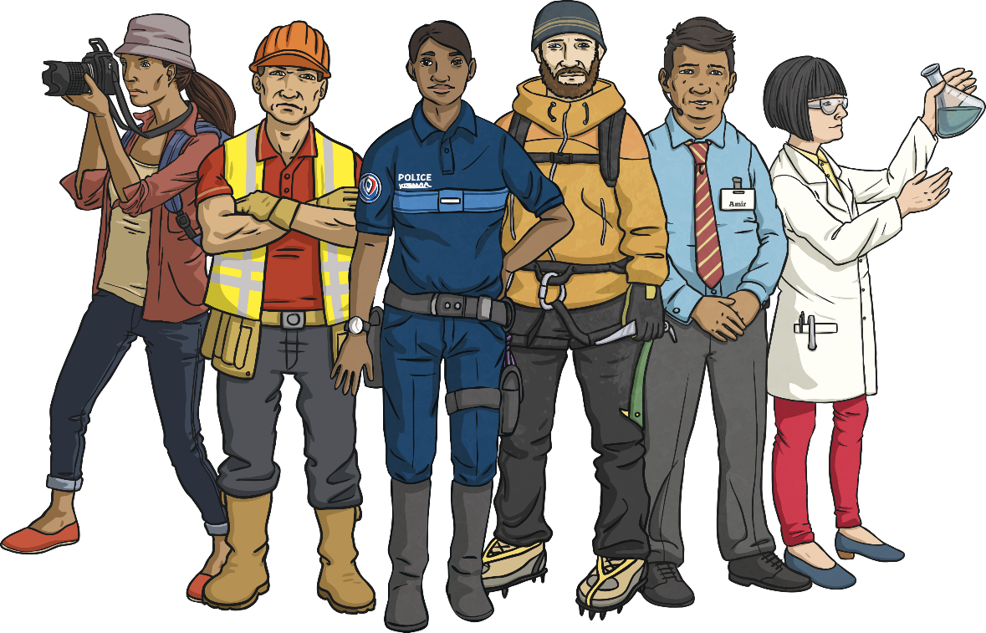
Making a Community
A community is a group of people living or working in the same place.
It is made up of the people who live there or belong to it.
The people of a community make it what it is. Their choices and actions can help make a community a positive place; they can also make it a negative place.
It is important we all make choices which help the communities we are a part of to be happy and successful places.
We can choose to be kind, helpful, thoughtful and selfless, thinking of the needs of others and not just our own.

Slide 6
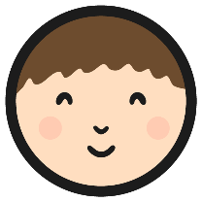
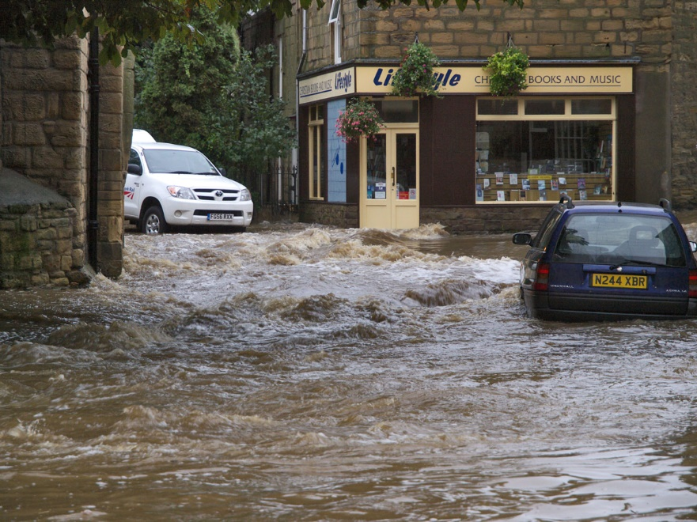
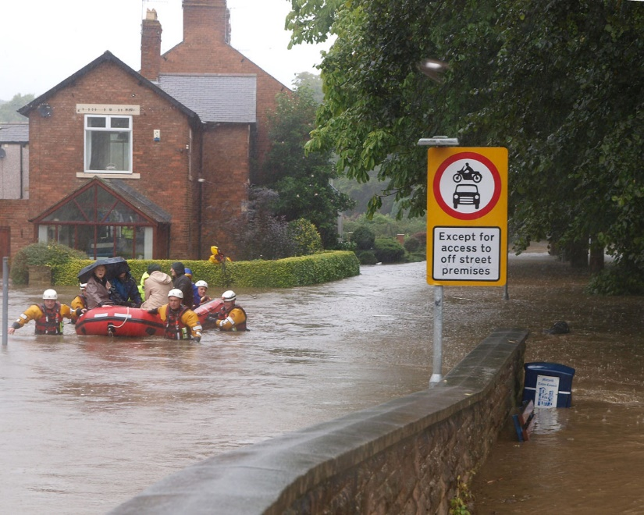
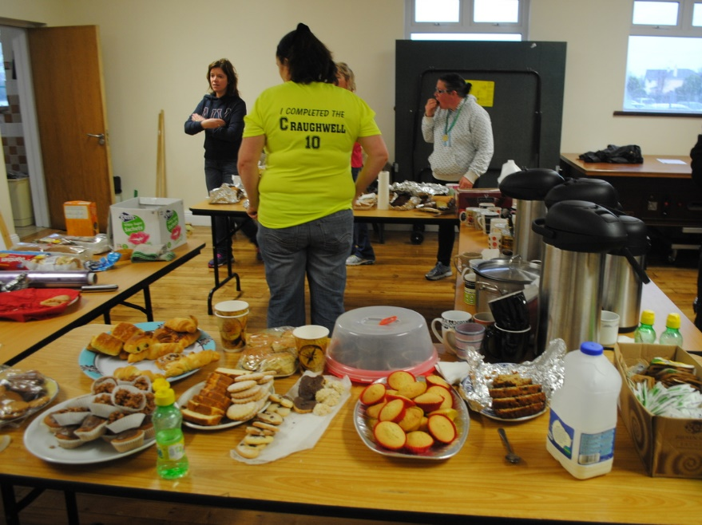
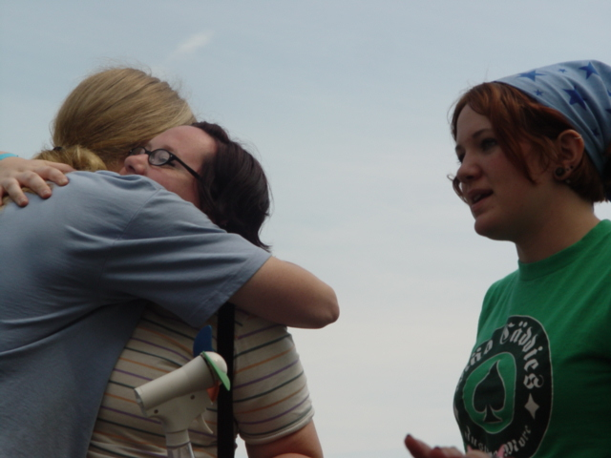
Being Part of a Community
Have a look at the images below.
What can you see? What has happened? What are the people of the community doing to help?
Photo courtesy of Johndal (@flickr.com) - granted under creative commons licence
Photo courtesy of Peter Mooney (@flickr.com) - granted under creative commons licence
Photo courtesy of Klif (@flickr.com) - granted under creative commons licence
Photo courtesy of Johndal (@flickr.com) - granted under creative commons licence

Slide 7
Match the key word to it's definition
Local
In your neighbourhood.
National
In a country.
Global
In the whole world.
Faith
In a certain religion.

Slide 8
School ( Wembley Primary School)
Teachers
Classmates
Dinner ladies
Friends
My community
Make a mind map of your own community
https://www.youtube.com/watch?v=ncfAz313Alc&t=16s

