Slide 1
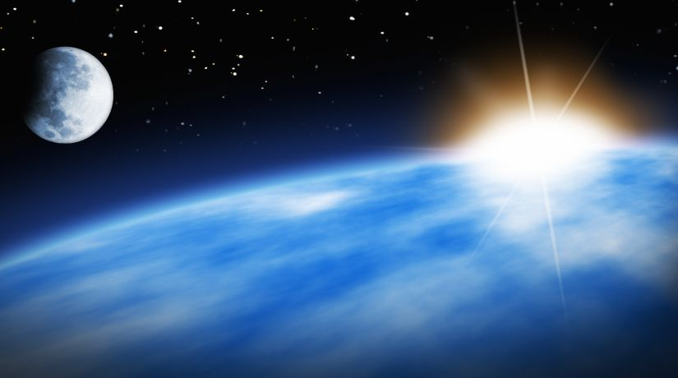
LIGHT

Slide 2
Why is light such a powerful symbol?

Slide 3
When you think of light what do you think of? Why?

Slide 4
Think about what brings light into your life. Why ?

Slide 5
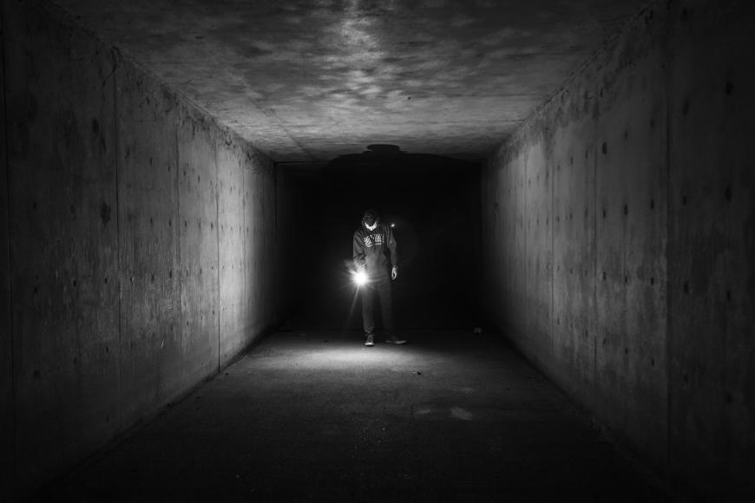
When you look at this image what do you think?

Slide 6
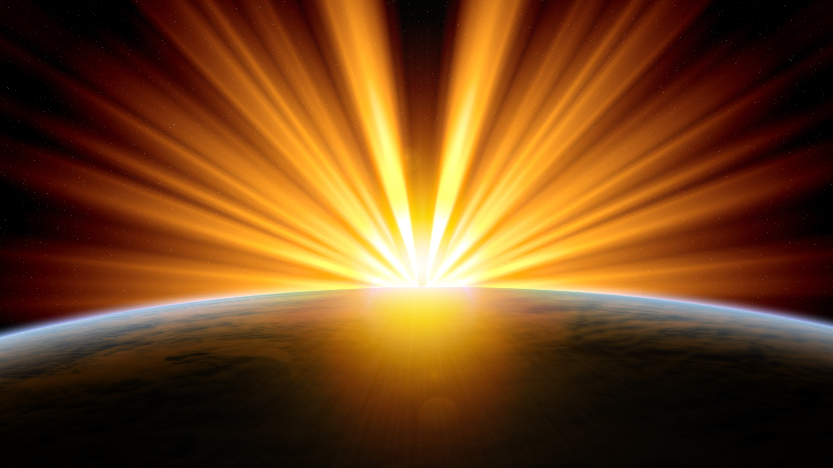
What about this image?

Slide 7
Light is a form of energy that enables us to see all the things around us. Darkness is when there is very little light.

Slide 8
Your task: You will have two images. Write detailed descriptions about the images. Think about what light represents and what darkness often represents.
Success criteria:
I can explain what light is.
I can explain what darkness is.
I can write a description about an image using key words to explain.

Slide 9
EXAMPLE: The boy is walking through a dark, secluded, abandoned tunnel which leads to a gloomy, pitch black room. His bright torch illuminated the path ahead, leading him into the unknown. The walls stood like armed guardians protecting this forbidden sight and the cold brought a shiver down his spine as he continued to walk fearfully.

